Slide 1


Grade: 11
Module 3
Lesson 2
Jack London

Slide 2

11.4.2 - understand specific information and detail in extended texts on a wide range of familiar and unfamiliar general and curricular topics;
11.4.4 - read a wide range of extended fiction and non-fiction texts on a variety of more complex and abstract general and curricular topics.
Learning objectives:

Slide 3


Assessment criteria
You will be able to:
use speaking and listening skills to solve problems;
recognize the attitude, opinion or tone of the writer.

Slide 4

I would rather be ashes than dust! I would rather that my spark should burn out in a brilliant blaze than it should be stifled by dry-rot. I would rather be a superb meteor, every atom of me in magnificent glow, than a sleepy and permanent planet. The proper function of man is to live, not exist. I shall not waste my days in trying to prolong them, I shall use my time."
– Jack London 1876-1916

Slide 5
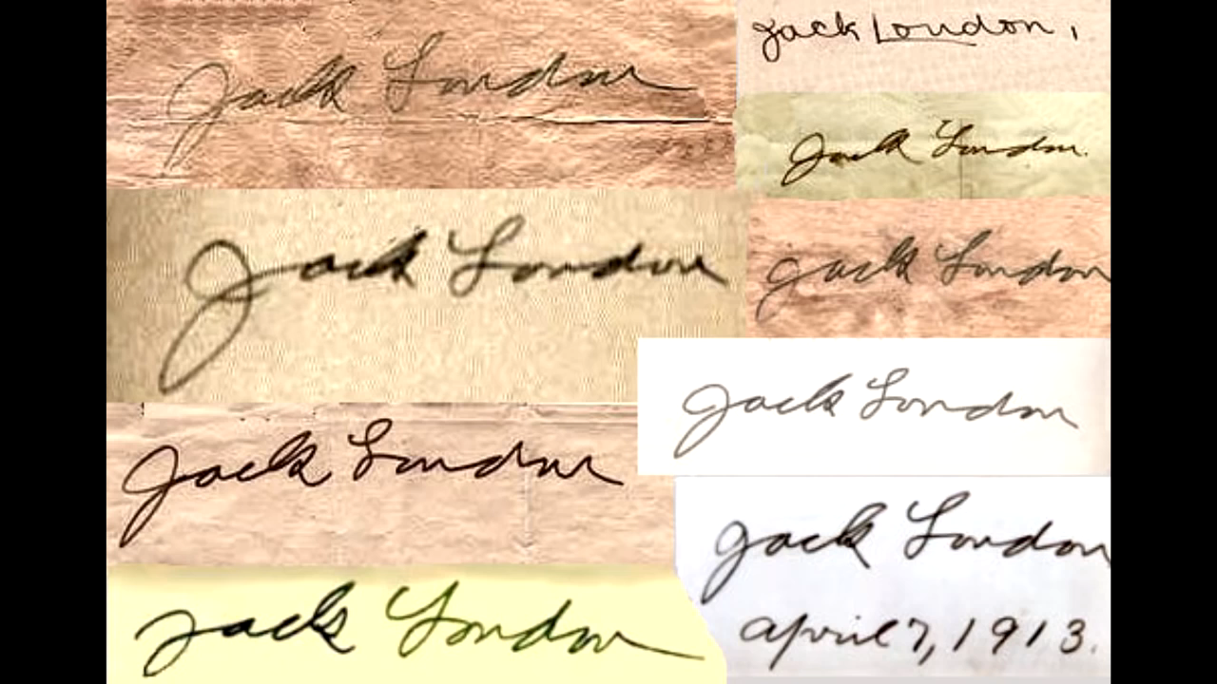

Slide 6
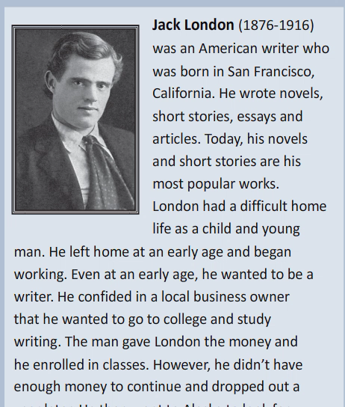

Slide 7
JACK LONDON
1.Where and when was Jack London born?
2.How could he afford to go to University?
3.Why did he go to the Klondike region?
4.What was his first successful piece of writing?
5.Which novels is he best known for?

Slide 8

1. Jack London was born
………………………………………………..
In 1876 in San Francisco, California.

Slide 9
2. He could afford to go to university
………………………………………………..
because a local business owner gave him the money.

Slide 10
3.He went to the klondike region
………………………………………………..
to look for gold.

Slide 11
4.His first successful piece of writing was
………………………………………………..
a story that magazine published and paid him a small amount of money for.

Slide 12
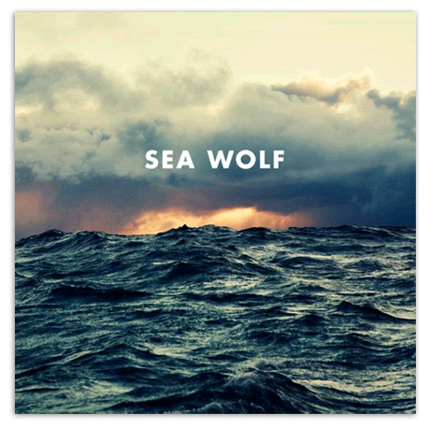

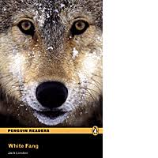
The
Call of the Wild, The Sea-Wolf and White Fang.
5.He is best known for the novels
………………………………………………..

Slide 13


Slide 14

Recommended H/W:
Find more information about Jack London’s years of life & works.

Slide 15


Conclusion
We have:
used speaking and listening skills to solve problems;
recognized the attitude, opinion or tone of the writer.

