Slide 1
EQUATION INVOLVING AN ABSOLUTE VALUE
ALGEBRA

Slide 2
CHAPTER no 6
Absolute value of equation.
You will be able to:
Know the definition of absolute value of a function.
Know the definition of modules of a function
Know the definition of square of a function in module
ALGEBRA | 4-term | Week no 3 | 2019-2020

Slide 3
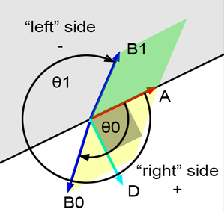
CHAPTER no 6
Absolute value of equation
Definition:
On the real number line, the absolute value of x is the distance from the origin to the point x. For example, there are two points whose distance from the origin is three units, -3 and 3. So the equation │x│ = 3 has two solutions, 3 and -3. Let us first remember the mathematical definition of absolute value.
ALGEBRA | 4-term | Week no 3 | 2019-2020

Slide 4

CHAPTER no 6
Absolute value of equation
Example:
Solve the equation $\text{│}$x – 2 $\text{│}$ = 5
Case 1
If x – 2 ≥ 0 ; x ≥ 2
x - 2 = 5
x = 7
Case 2
If x-2 < 0 ; x < 2
-(x – 2) = 5
x = -3
So the solutions are -3 and 7
ALGEBRA | 4-term | Week no 3 | 2019-2020

Slide 5
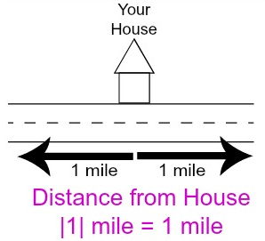
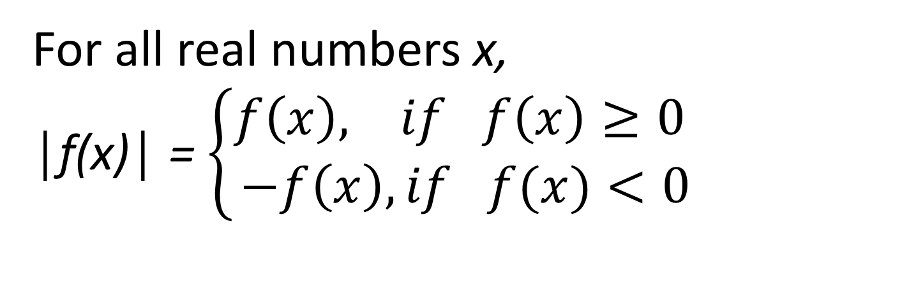
CHAPTER no 6
Absolute value of equation
Definition:
For all real numbers x,
│f(x)│ = $\left\{\begin{aligned}f\left(x\right), if f\left(x\right)≥0 \\ −f\left(x\right), if f(x)<0\end{aligned}\right.$
ALGEBRA | 4-term | Week no 3 | 2019-2020

Slide 6
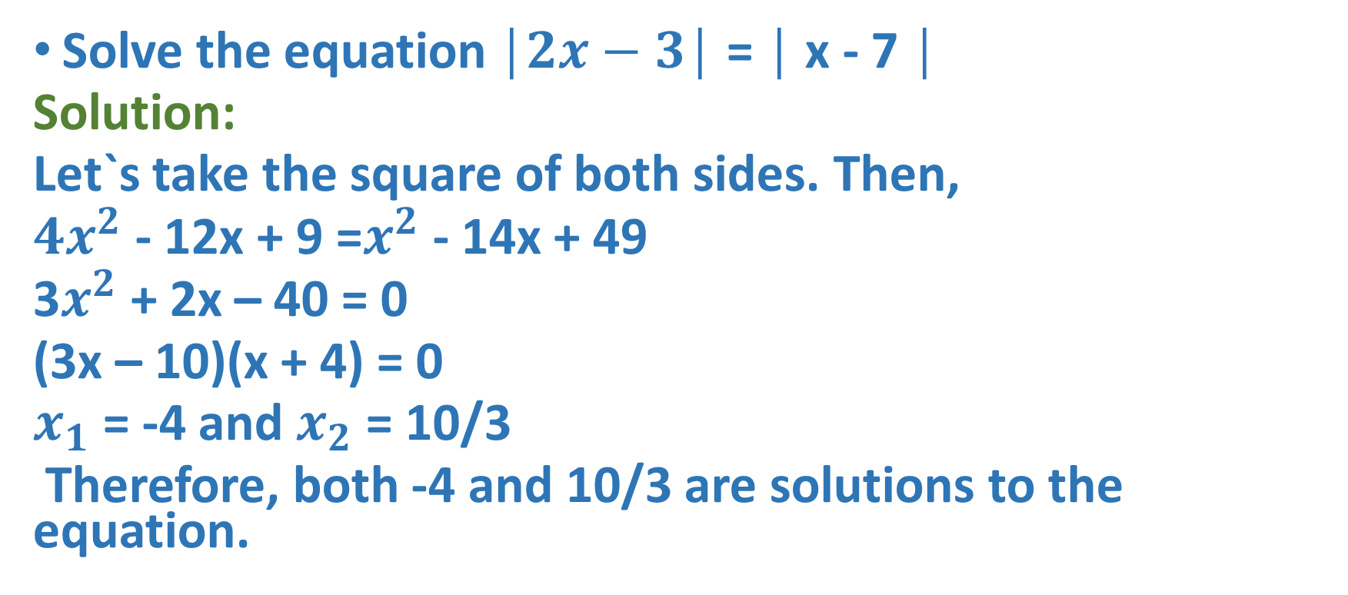
CHAPTER no 6
Absolute value of equation
Example:
Solve the equation $\text{│}2x−3\text{│}$ = $\text{│}$x - 7 $\text{│}$
Solution:
Let`s take the square of both sides. Then,
$4x^{2}$ - 12x + 9 =$x^{2}$ - 14x + 49
3$x^{2}$ + 2x – 40 = 0
(3x – 10)(x + 4) = 0
$x_{1}$ = -4 and $x_{2}$ = 10/3
Therefore, both -4 and 10/3 are solutions to the equation.

Slide 7
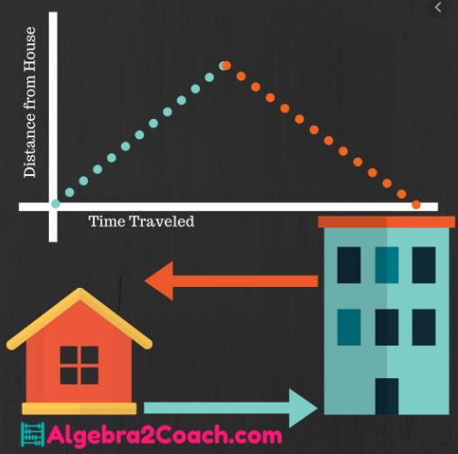
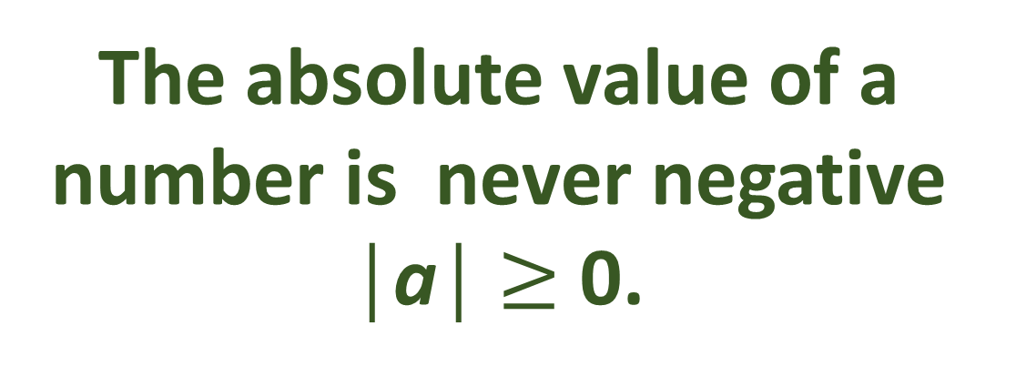
CHAPTER no 6
Absolute value of equation
Rule:
The absolute value of a number is never negative │a│ $≥$ 0.
ALGEBRA | 4-term | Week no 3 | 2019-2020

Slide 8
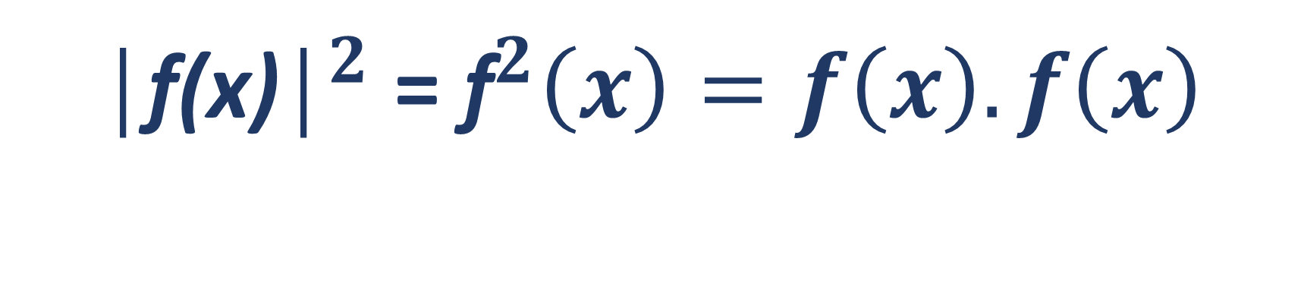
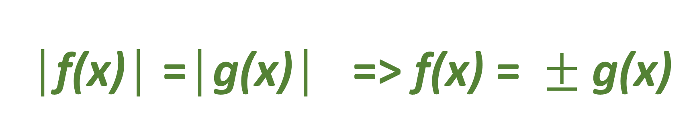
CHAPTER no 6
Absolute value of equation
Definition:
${\text{│}\text{f}\text{(}\text{x}\text{)│}}^{2}$ = ${\text{f}}^{2}\left(x\right)=f\left(x\right).f\left(x\right)$
$\text{│}\text{f}\text{(}\text{x}\text{)│}\text{ =}\text{│}\text{g}\text{(}\text{x}\text{)│}$ => $\text{f}\text{(}\text{x}\text{)}\text{ = }±\text{g}\text{(}\text{x}\text{)}$
ALGEBRA | 4-term | Week no 3 | 2019-2020

Slide 9
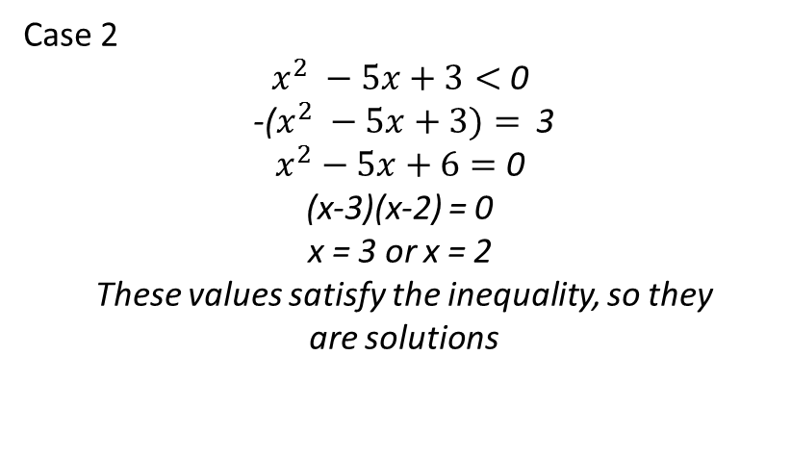

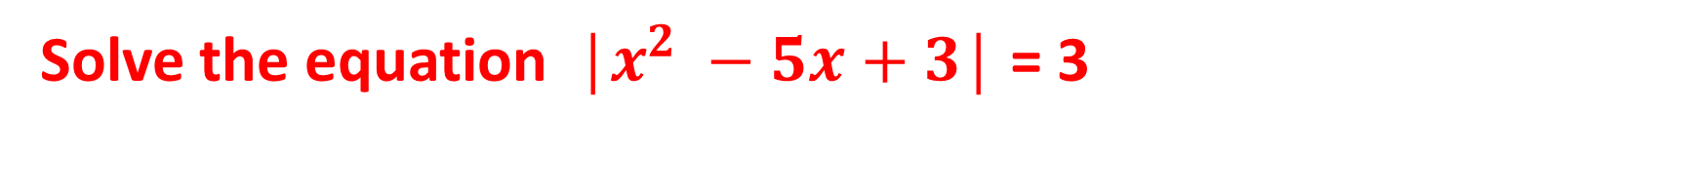
CHAPTER no 6
Absolute value of equation
Example:
Solve the equation ${\text{│}x}^{2} −5x+3\text{│}$ = 3
Case 1
$x^{2} −5x+3≥$ 0
$x^{2} −5x+3= 3$
$$x^{2} −5x=0$$
x(x – 5) = 0
x = 0 or x = 5
These values satisfy the inequality, so they
are solutions.
Case 2
$x^{2} −5x+3<$ 0
-($x^{2} −5x+3)=$ 3
$x^{2}−5x+6=$ 0
(x-3)(x-2) = 0
x = 3 or x = 2
These values satisfy the inequality, so they
are solutions
Hence, the solutions to the equation are 0, 2, 3, 5.
ALGEBRA | 4-term | Week no 3 | 2019-2020

Slide 10
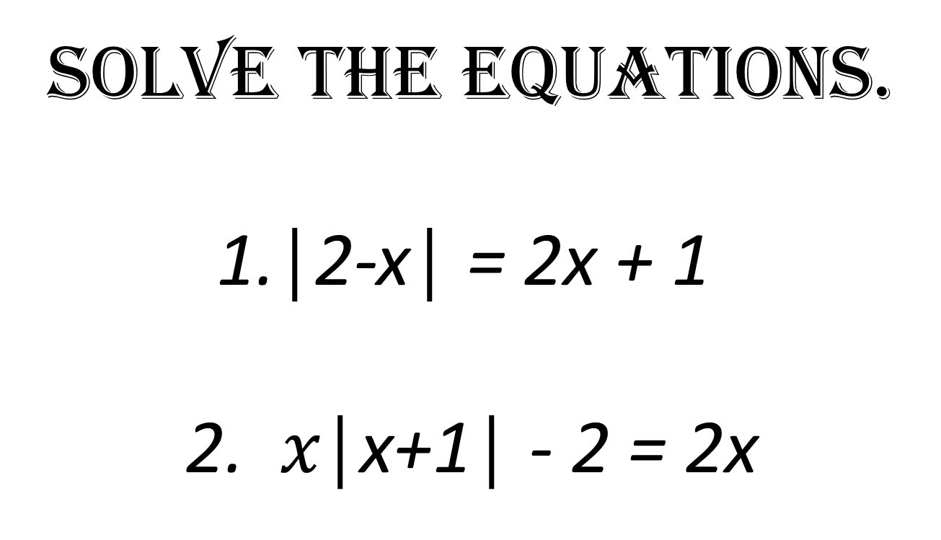
CHAPTER no 6
Absolute value of equation
Activity:
Solve the equations.
$\text{│}\text{2−}\text{x}\text{│}\text{ = 2}\text{x}\text{ + 1 }$
2. $x\text{│}\text{x}\text{+1│}$ - 2 = 2x
ALGEBRA | 4-term | Week no 3 | 2019-2020

Slide 11
CHAPTER no 6
Absolute value of equation
Resources:
https://www.khanacademy.org/math/algebra-home/alg-absolute-value/alg-absolute-value-equations/v/absolute-value-equations
https://www.mathsisfun.com/definitions/absolute-value.html
https://www.mathsisfun.com/links/core-high-school-functions.html
https://www.mathsisfun.com/links/core-high-school-algebra.html
https://www.mathsisfun.com/numbers/absolute-value.html
ALGEBRA | 4-term | Week no 3 | 2019-2020

