Slide 1
Subject:English language Grade:10 Module:9 Independent project

Slide 2
LANGUAGE IN USE
LEARNING OBJECTIVES(S)
10.4.1 - understand complex and abstract main points in extended texts on a wide range of familiar and unfamiliar general and curricular topics
10.4.3 - skim a range of lengthy texts with speed to identify content meriting closer reading on a range of more complex and abstract, general and curricular topics
10.4.4 - read a wide range of extended fiction and non-fiction texts on a variety of more complex and abstract general and curricular topics
10.3.1 - use formal and informal language registers in talk on a range of general and curricular topics, including some unfamiliar topics
10.2.2 - understand specific information in unsupported extended talk on a wide range of general and curricular topics, including talk on a growing range of unfamiliar topics
10.2.3 - understand the detail of an argument in unsupported extended talk on a wide range of general and curricular topics, including talk on a growing range of unfamiliar topics
10.5.2 - use a wide range of vocabulary, which is appropriate to topic and genre, and which is spelt accurately
10.1.5 - use feedback to set personal learning objectives
10.6.6 - use a growing variety of impersonal and cleft structures on a wide range of general and curricular topics
10.6.7 - use a wide variety of simple perfect active and passive forms and a variety of perfect continuous forms on a wide range of general and curricular topics
10.5.1 - plan, write, edit and proofread work at text level independently on a wide range of general and curricular topics
10.5.3 - write with grammatical accuracy on a wide range of general and curricular topics
10.5.4 - use style and register to achieve an appropriate degree of formality in a wide variety of written genres on general and curricular topics
10.5.6 - write coherently at text level using a variety of connectors on a wide range of familiar general and curricular topics
10.5.9 - punctuate written work at text level on a wide range of general and curricular topics with a good degree of accuracy

Slide 3
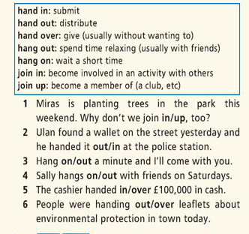
Ex 1 at page 122 Phrasal verbs/Prepositions Descriptor: Choose the correct particle
Answer Key:
1.in 2.in 3.on 4.out 5.over 6.out

Slide 4
Ex 2 at page 122 Descriptor: Choose the correct preposition
Answer Key:
1.to, 2.on, 3.under, 4.to, 5.to, 6.in

Slide 5
Ex 3 at page 122 Descriptor: Fill in: natural, long-term, free, process, starling, toxic.
Answer Key:
1.starling,2.long-term, 3.toxic,4.free 5.natural
6.process

Slide 6
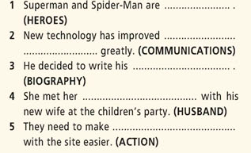
Word formation Ex 4 at page 122
Descriptor: Complete the sentences with correct word derived from the words in brackets. Use appropriate proxies.
Answer Key:
1.superheroes
2.telecommunications
3.autobiography
4.ex-husband
5.interaction

Slide 7
Ex 5 at page 122 WORD OFTEN CONFUSED Descriptor: Choose the correct word
Answer Key:
1. wandered, settled
2. grab, public
3. spent, biting
4. doubt

Slide 8
Further Practice – Quiz To consolidate information in the module
Descriptor: Mark the sentences T (true) or F (false). Correct the false sentences.
1 The Big Bang is thought to have taken place 10 billion years ago.
2 Telomerase is a protein.
3 Tomatoes contain lycopene.
4 Our body uses all of the oxygen it takes in
5 The Great Oxidation Event took place around 2 billion years ago
6 A sneeze can reach a speed of 100 kmph
7 Around 30% of men snore.
8 The Cyclical Universe Theory suggests that there is more than one universe.
Answer Key:
1. F (14 billion years ago) 2. F (enzyme) 3.T 4. F (98%)5.T 6. F ( 160 kmph) 7.F (45% men, 30% women) 8. F (Multiple Universe Theory)

Slide 9


Slide 10
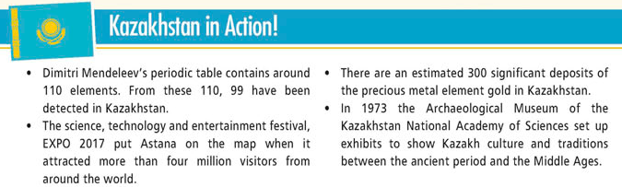
Kazakhstan in Action! Descriptor: Read and choose the correct word
HOMEWORK

