Slide 1

Greetings and names: His name is…/
Her name is…

Slide 2
Learning objectives(s) that this lesson is contributing to
1R1. Understand the main points in a growing range of short, simple texts on general and curricular topics
1.S6 exchange simple greetings and say “please”, “sorry” and “thank you”
1.S1 make basic personal statements and simple statements about objects

Slide 3
Lesson objectives
All learners will be able to:
Introduce themselves
Understand questions and answers correctly
Introduce their friends His /Her name is.
Most learners will be able to:
Listen and repeat, follow simple greeting
Perform total physical response routines
Understand simple sentences.
Some learners will be able to:
Recognise & say the names of each other
Ask & answer the questions

Slide 4

Hello - Сәлеметсіз бе
Hi - Сәлем
How are you? - Қалыңыз қалай?
I’m fine, thank you - Жақсы, рахмет
What is your name? - Сенің атың кім?
My name is … - Менің атым ...
Nice to meet you - Сізбен танысқаныма қуаныштымын

Slide 5

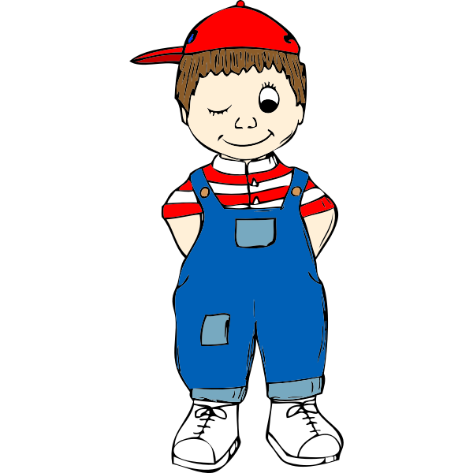


Her
His
His name is ….
(Ұл балаға)
Her name is ….
(Қыз балаға)

Slide 6


Slide 7
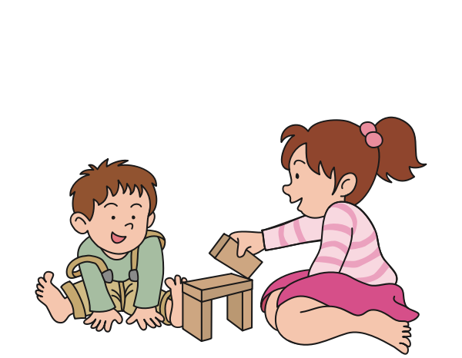
Her name is Madina
His name is Aset
Оның есімі - Мадина
Оның есімі - Асет
Madina
Aset

Slide 8

Write her and his.
… name is Amina
… name is Dastan
… name is Malika
… name is Assan

Slide 9


Slide 10
