Slide 1
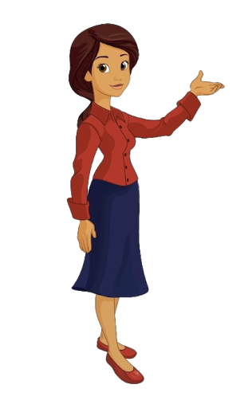
Parts of Body
Grade 1 unit:6
Lesson objectives
1.Remember the words;
2.Listen and repeat together the words;
3.Vocabulary work;
4.Asks and answers the questions

Slide 2
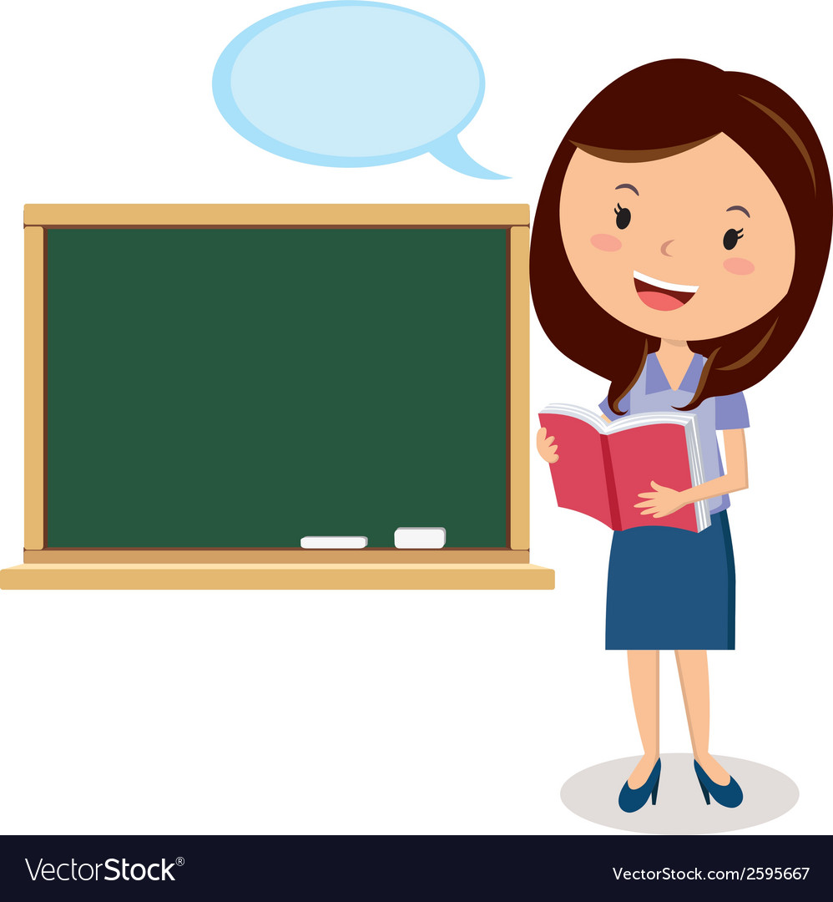
Hello children!
How are you today?
The theme of our lesson “Parts of Body”
Today we will repeat and remember the words.
Then, children let's start our lesson
I’m glad to see you

Slide 3

Now children let’s repeat the words together

Slide 4
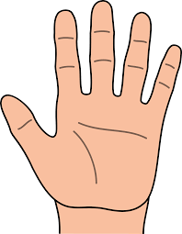
Hand-[hænd]-қол

Slide 5
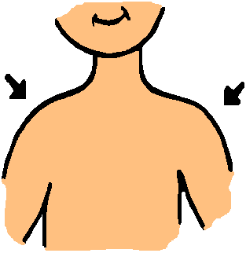
Shoulder- [ˈʃəʊldə]-иық

Slide 6
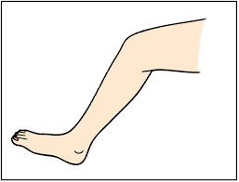
Leg- [leg]-аяқ

Slide 7
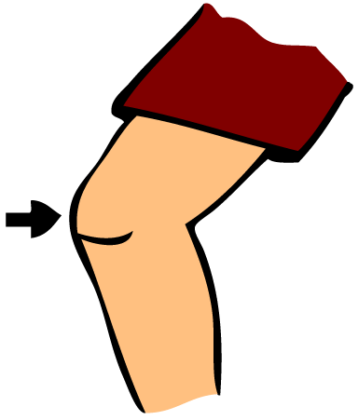
knee -[niː]-тізе

Slide 8
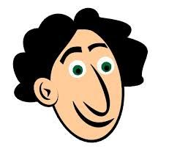
head -[hed]-бас

Slide 9
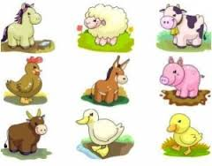
Ok, Let’s do this exercise Flashcards with animal pictures. For example:This is a cow. It has 4 legs and 2 big brown eyes.

Slide 10
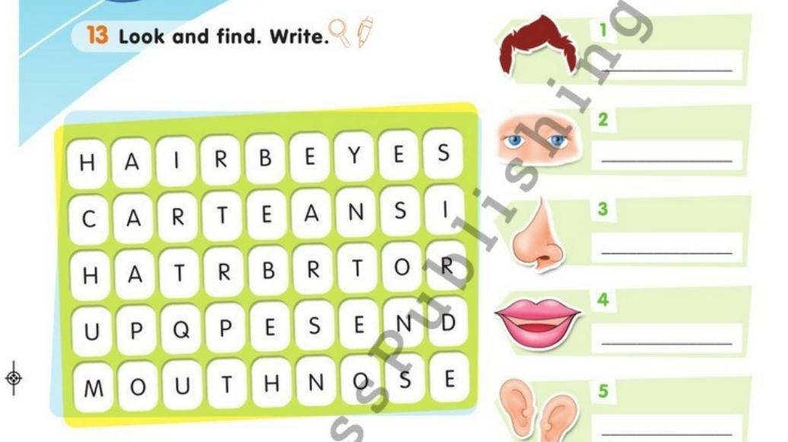
Open your Pupil’s book page 80, exercise 13.
Look and find.Write

Slide 11

Home task
Activity book, page 94, exercise 4

Slide 12
Good bye, children!

