Slide 1

Parts of Body
Grade 1
Unit 6

Slide 2
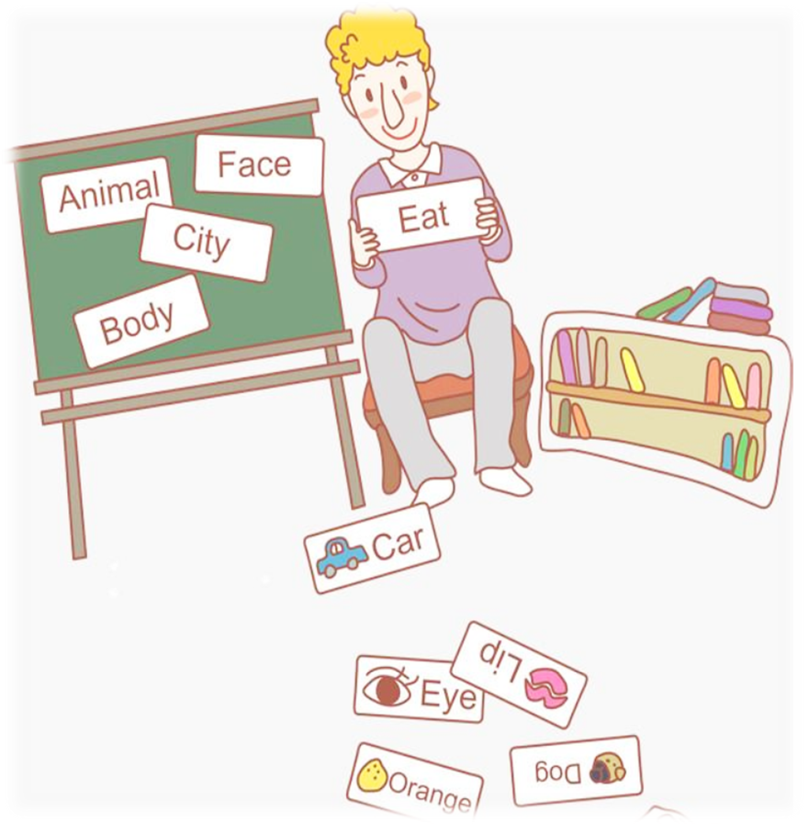
Let`s start our lesson. Today we will repeat the theme
`Parts of Body`
All learners will be able to:
• Recognize 8-10 words of body parts
• pronounce familiar words and expressions intelligibly
Most learners will be able to:
• Name 5 -7 body parts
• pronounce familiar words and expressions intelligibly
Some learners will be able to:
• Name 10 body parts
• pronounce familiar words and expressions intelligibly

Slide 3
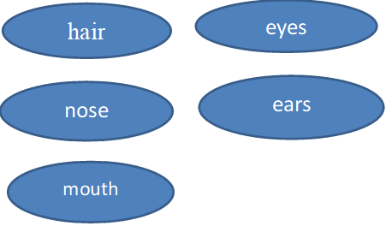
Checking up the home task with flashcards

Slide 4
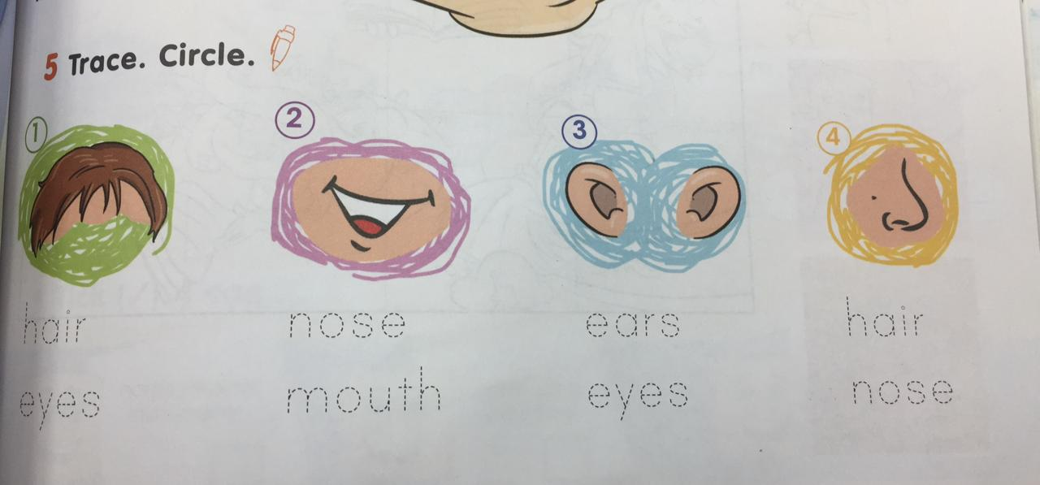
Ex 5 p63 Activity book

Slide 5
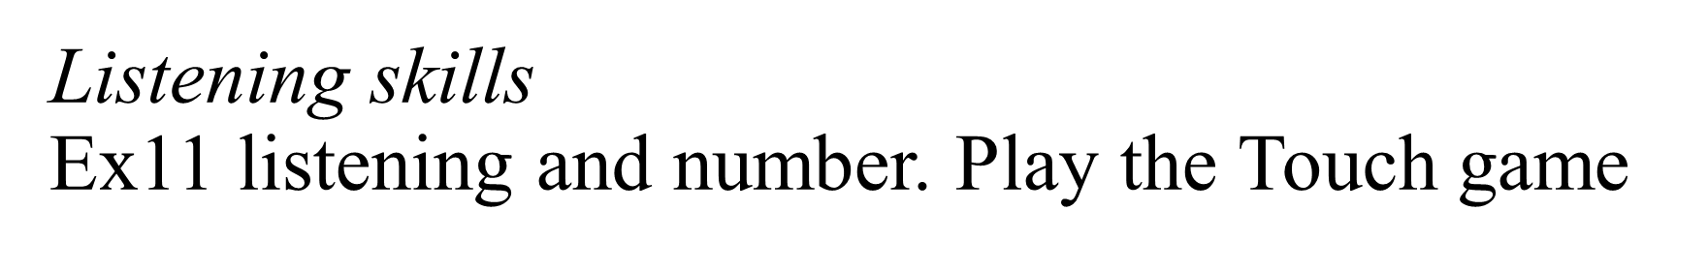
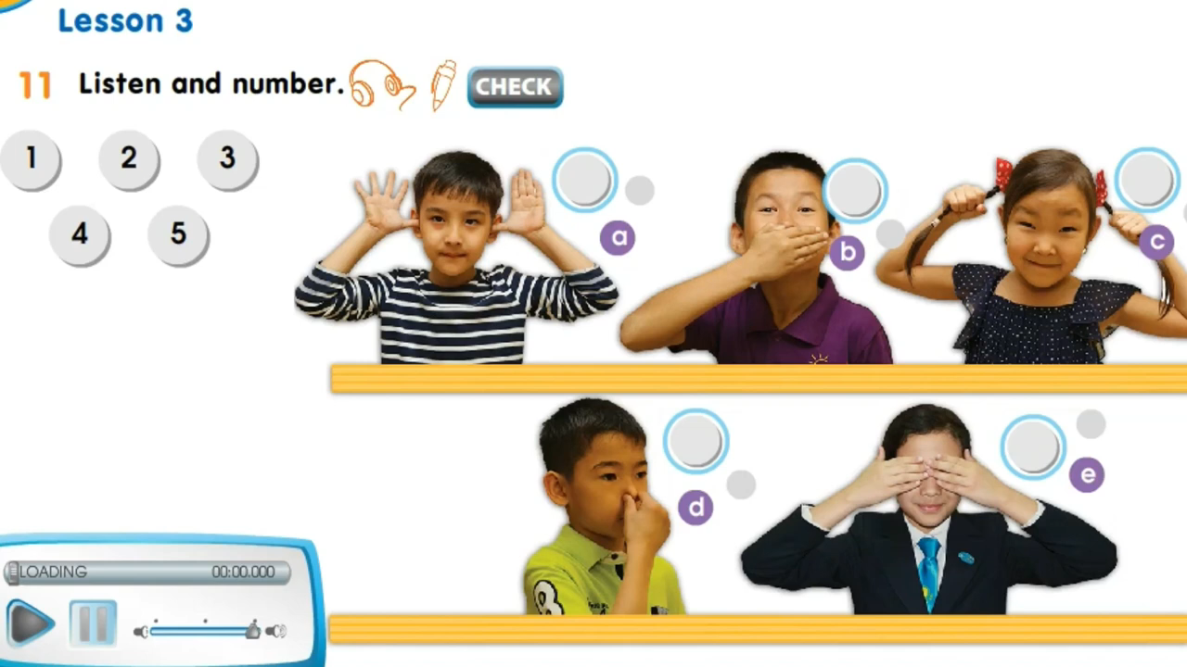

Slide 6
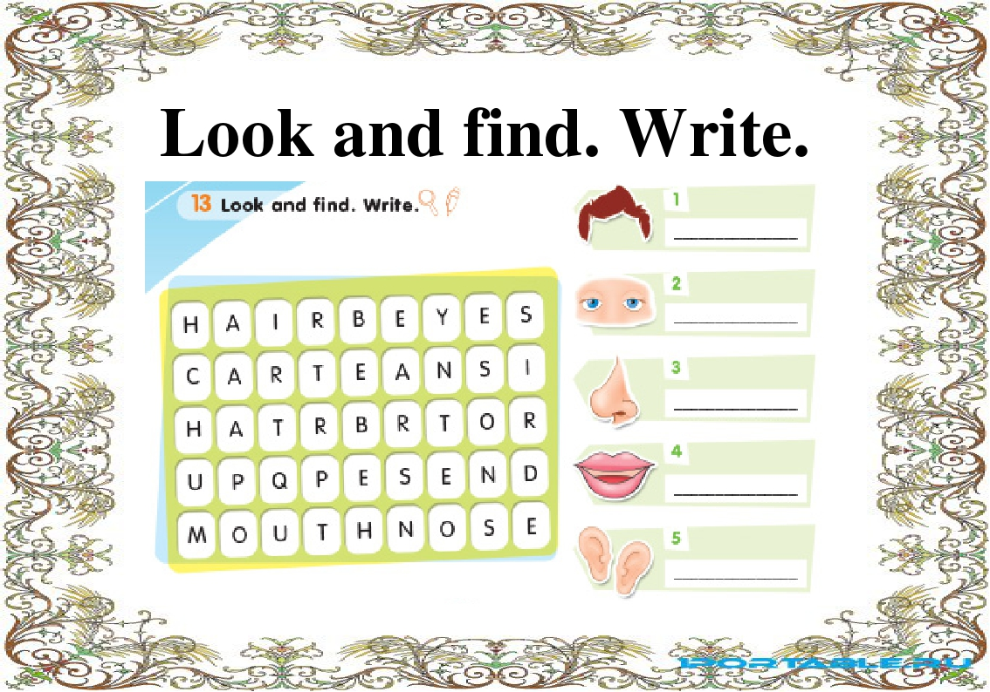
Ex 13 look and find. Write

Slide 7
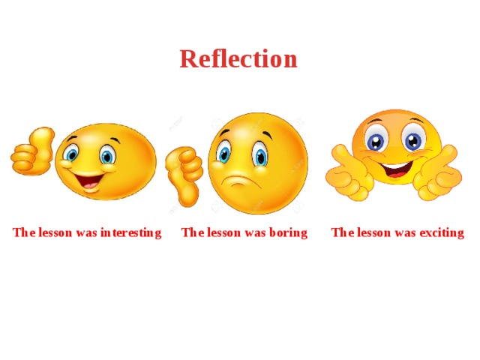

Slide 8
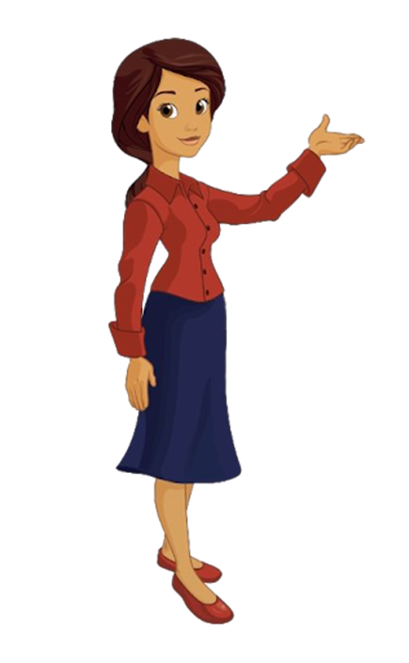
Home task:
Revision of the words.
The lesson is over! Good bye

