Slide 1

Theme of the lesson: Greetings and names

Slide 2
Learning objectives(s) that this lesson is contributing to
1.L3 recognise with support simple greetings
recognise the spoken form of a limited range of basic and everyday classroom words
1.S1 make basic personal statements and simple statements about objects
1.S6 exchange simple greetings and say “please”, “sorry” and “thank you”

Slide 3
Lesson objectives
All learners will be able to:
· Say simple greeting “Hello”
· Understand questions: What is your name? How are you?
· Use answers correctly: I am fine, thank you
· Introduce their friends His /Her name is.
Most learners will be able to:
· Listen and repeat, follow simple greeting
· Perform total physical response routines
· Understand simple songs.
Some learners will be able to:
· Recognise & say the names of each other
· Ask & answer the questions

Slide 4




Сәлеметсіз бе
Сәлем

Slide 5
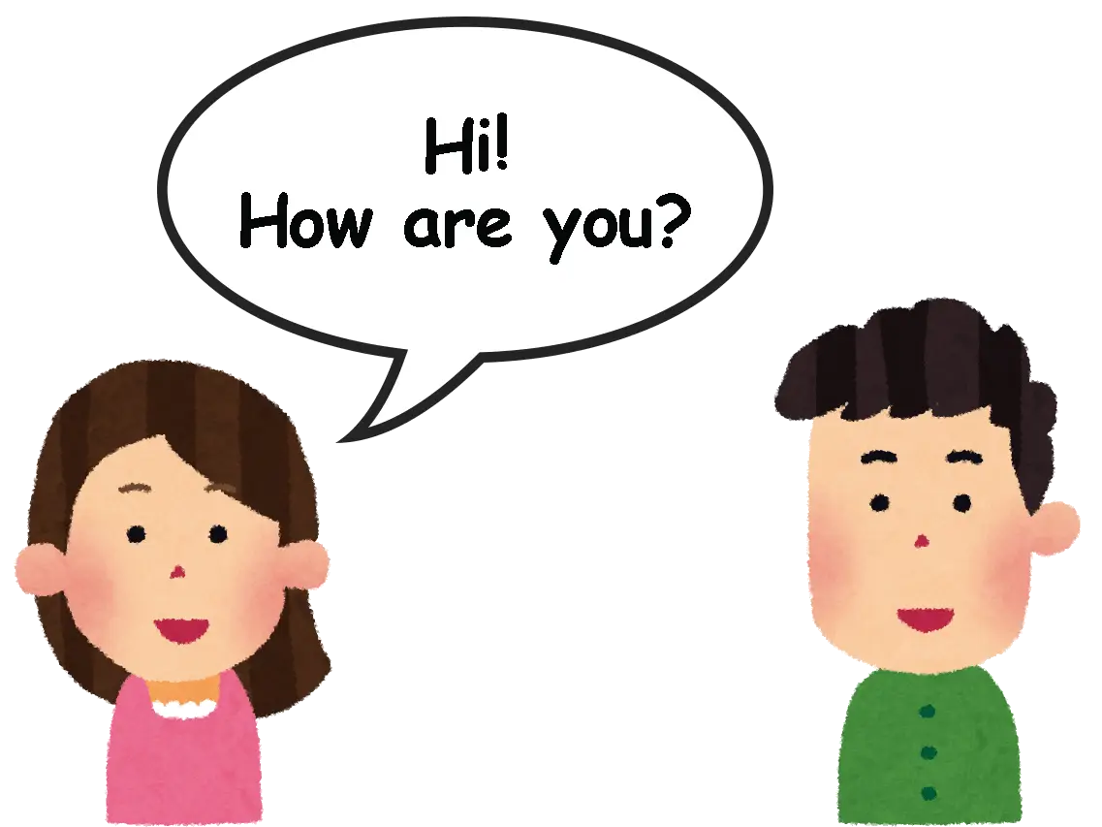
How are you? - Қалыңыз қалай?

Slide 6
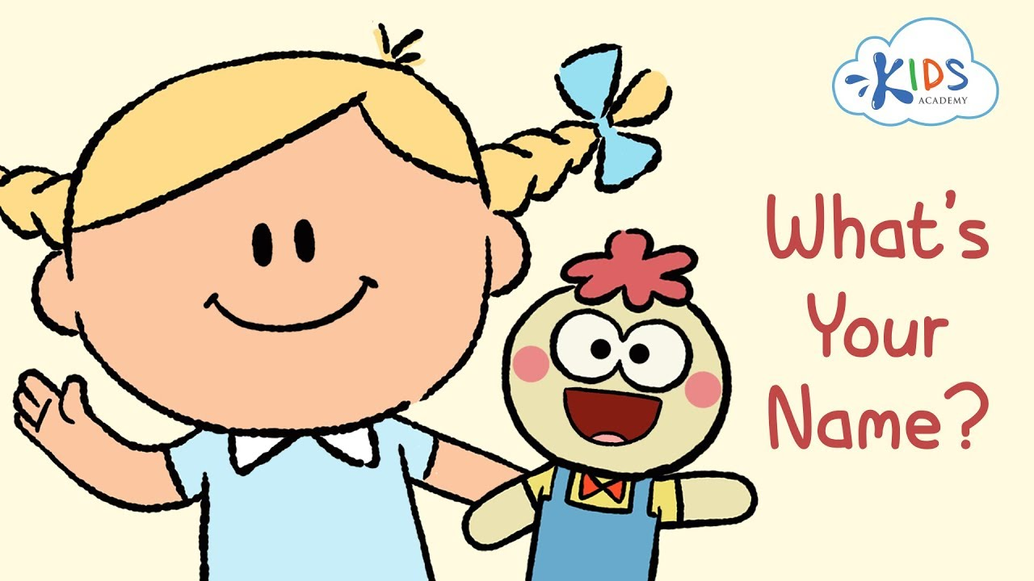
What is your name? - Сенің атың кім?

Slide 7
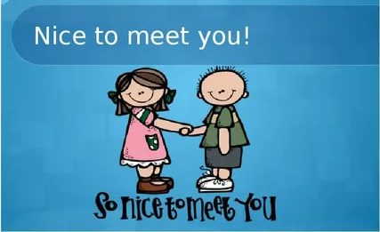
Nice to meet you - Сізбен танысқаныма қуаныштымын

Slide 8
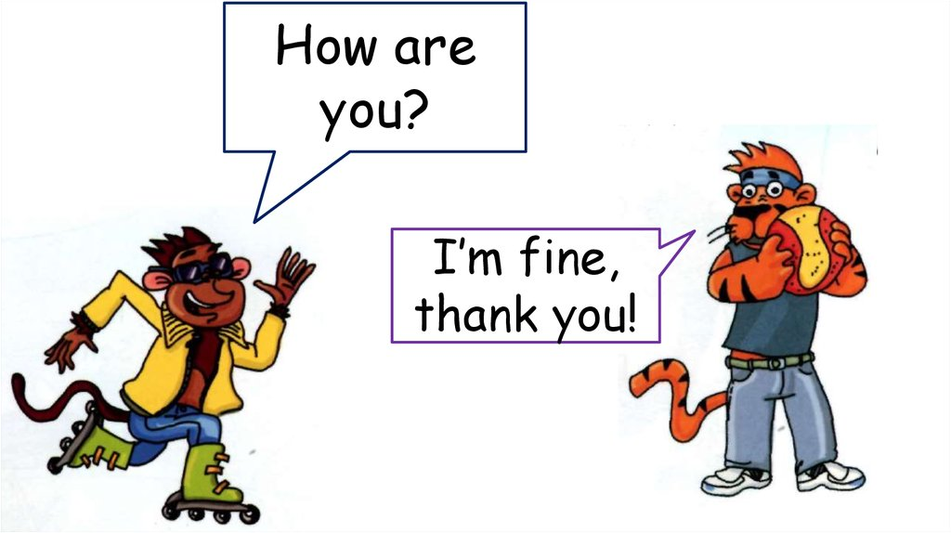
I’m fine, thank you! - Менде бәрі жақсы, рахмет!

Slide 9

My name is … - Менің атым …

Slide 10
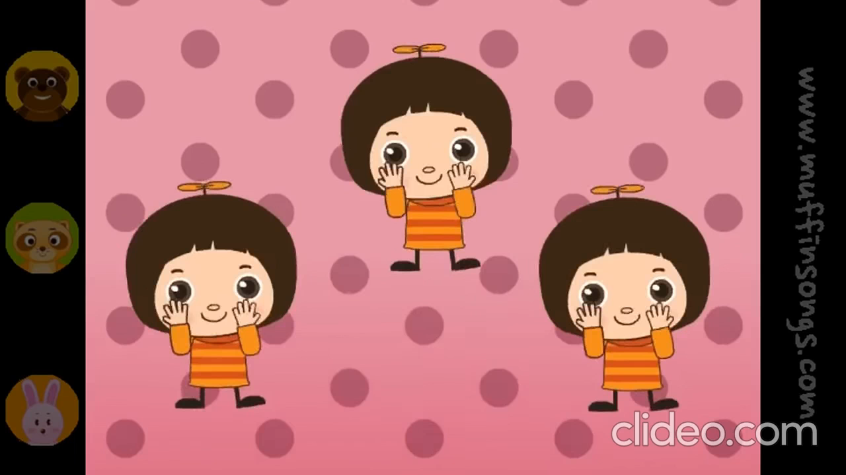

Slide 11

Game “Names”
My name is ...
My name is ...
My name is ...
My name is ...

Slide 12

How are you?
I’m fine, thank you
Nice to meet you

Slide 13
Feedback
Can you say simple greetings?
Do you understand questions: What is your name? How are you?

Slide 14
