Slide 1
Everyday routines

Slide 2
Learning objectives
1. use personal subject pronouns to identify things
1.S3 pronounce basic words and expressions intelligibly
1.L1 recognise short instructions for basic classroom routines spoken slowly and distinctly
Use can/can’t to describe ability

Slide 3
Lesson objectives
All learners will be able to:
listen and repeat the words according to the topic;
Most learners will be able to:
recognise and name some words according to the topic;
Some learners will be able to:
recognise and name most of the words according to the topic

Slide 4
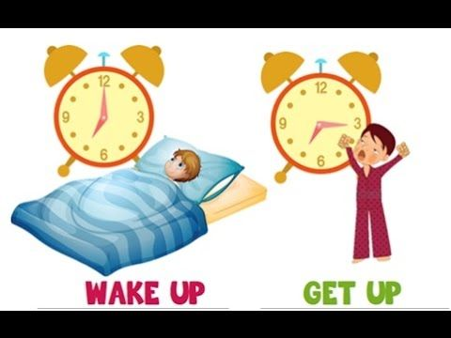
Wake up – ояну
Get up - тұру

Slide 5

Wash my face – бетті жуу

Slide 6
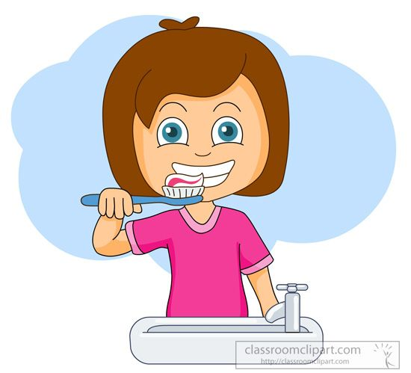
Brush my teeth – тісті тазалау

Slide 7

Make my bed – төсек жинау

Slide 8
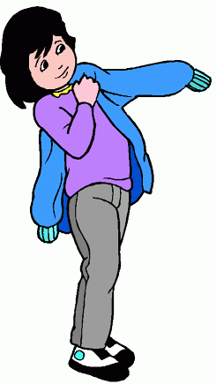
Put on - киіну

Slide 9

Go to school – мектепке бару

Slide 10

Go to bed - ұйықтау

Slide 11

Let’s watch the video!

Slide 12

ҰМЫТПА!
I CAN
Мен жасай аламын
I CAN’T
Мен жасай алмаймын

Slide 13
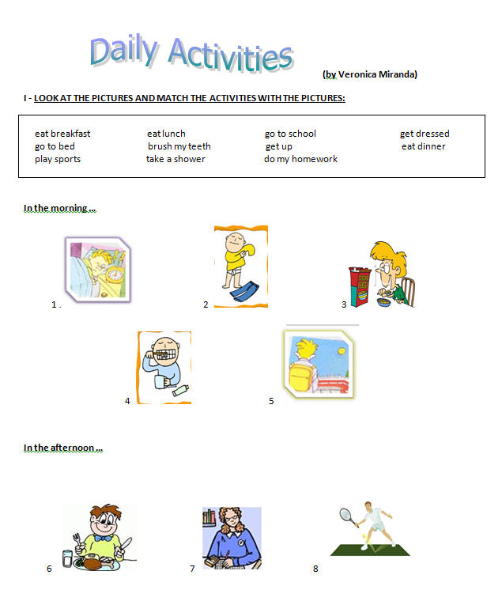

Slide 14
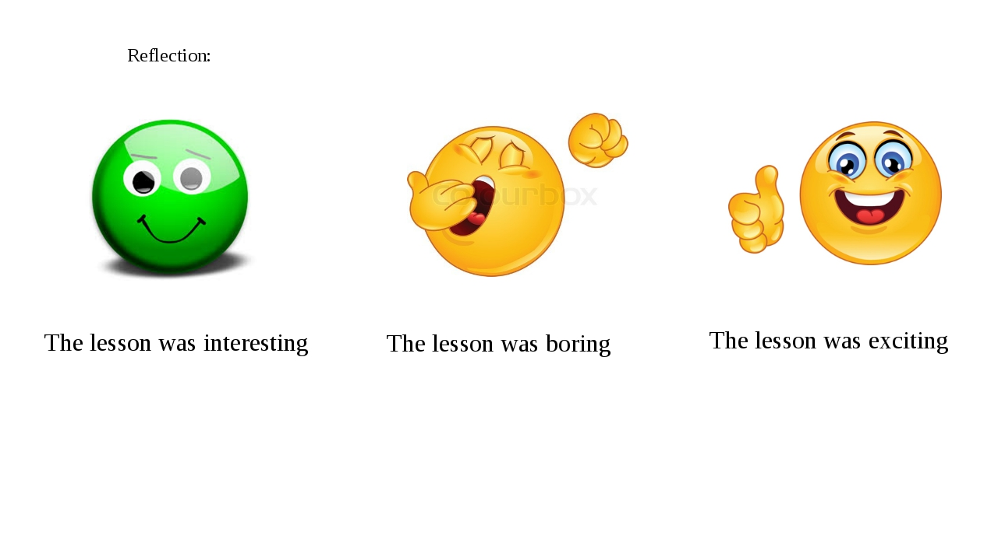

Slide 15


