Slide 1
Getting to school : How do you get to school?

Slide 2
Learning objectives
1. L4. Pronounce familiar words and expressions intelligibly
1. S5. Use words in short exchanges
1. UE5. Use interrogative pronouns which, what where, how to ask basic questions

Slide 3
Lesson objectives
All learners will be able to:
Recognize short basic instructions for a limited range of basic common personal questions
Most learners will be able to:
Use words in short exchanges
Some learners will be able to:
Make basic questions using interrogative pronouns

Slide 4
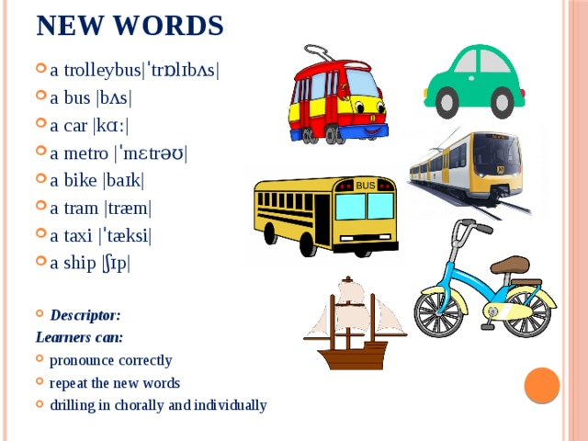

Slide 5
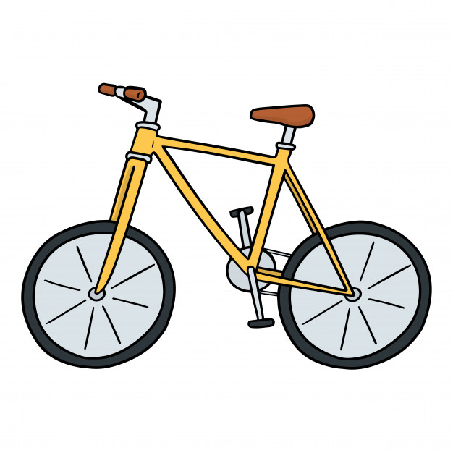
What is it?
It is a bicycle.
What colour is it? It is yellow.

Slide 6
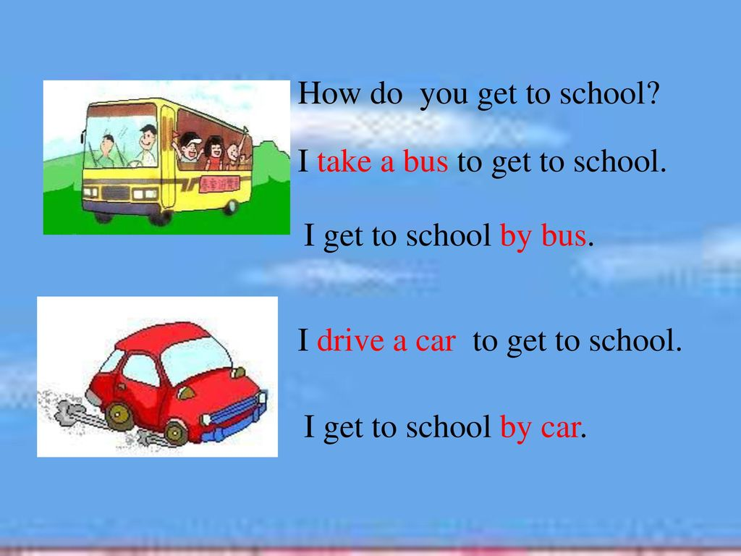


Slide 7
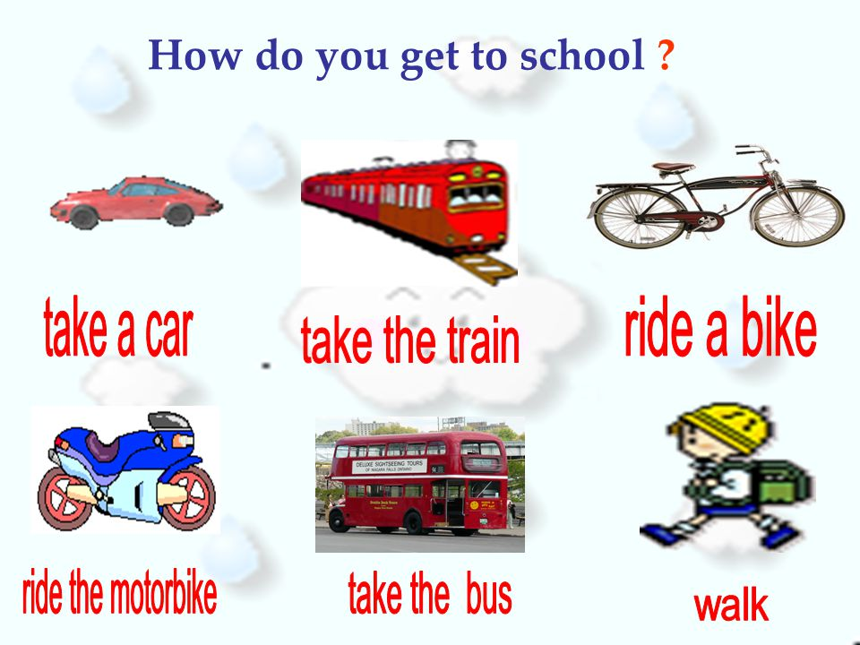

Slide 8
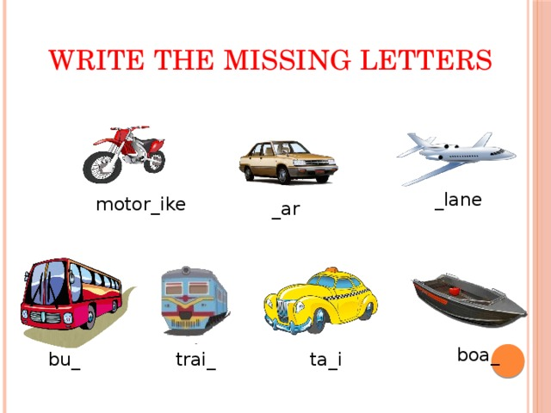

Slide 9
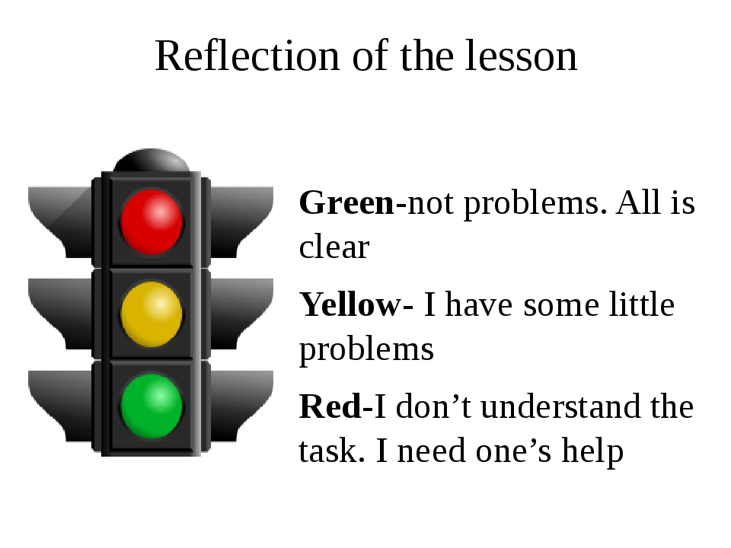

Slide 10
GOOD BYE!

