Slide 1
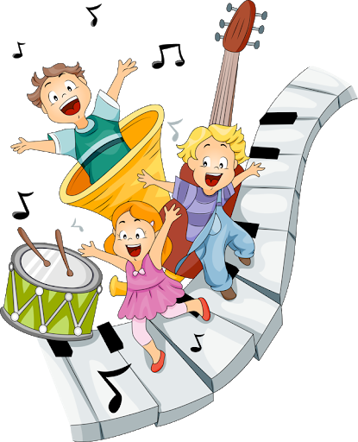
STORYTIME
Grade 1 unit:6 ''MY MUSIC''

Slide 2

Hello dear students!
How are you today?
I’m glad to see you!
The theme of our lesson ''My music''
Today we will learn new words and also learn new musical instruments.
Then,children let's start our lesson

Slide 3

Lesson objectives
1.Learn new words
2. Listen and repeat together new words.
3. Brainstorming ;
4.Vocabulary work;
5.Asks and answers the questions using the structure: Can you ? I can ….

Slide 4
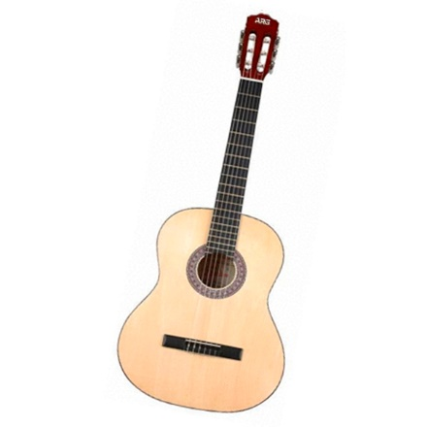
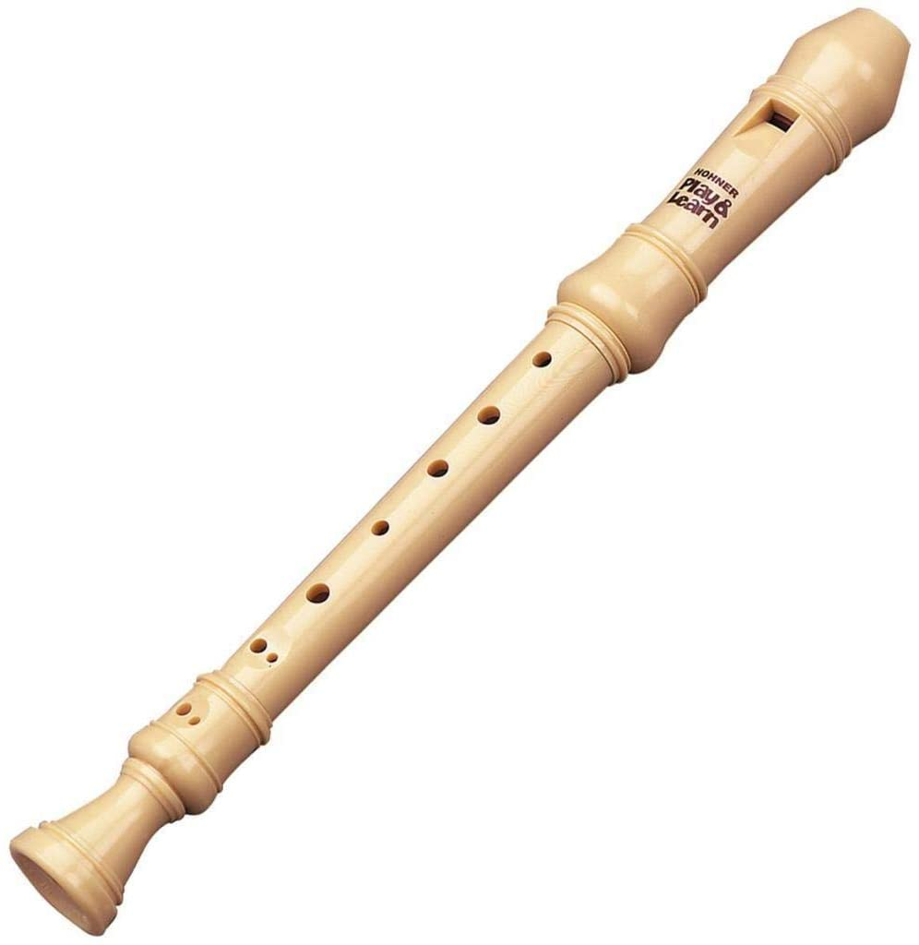


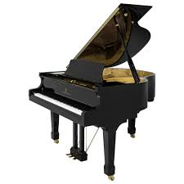
Learn new words
1.Guitar [gɪˈtɑː]Гитара
3.Recorder [rɪˈkɔːdə] Сыбызғы
2.Drum [drʌm] Дауылпаз
4.Piano [pɪˈænəʊ] Күй сандық
5.Trumpet [ˈtrʌmpɪt]Саз керней

Slide 5

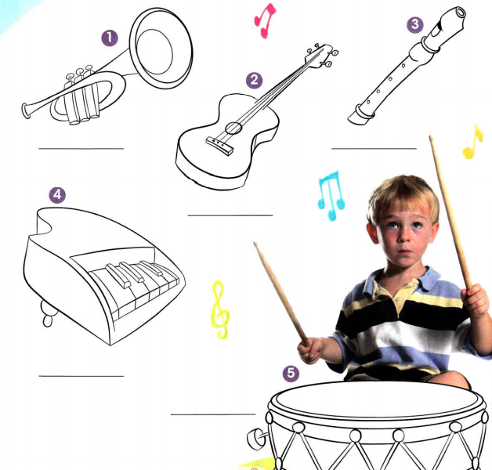
Colour.Listining.Write and do…

Slide 6
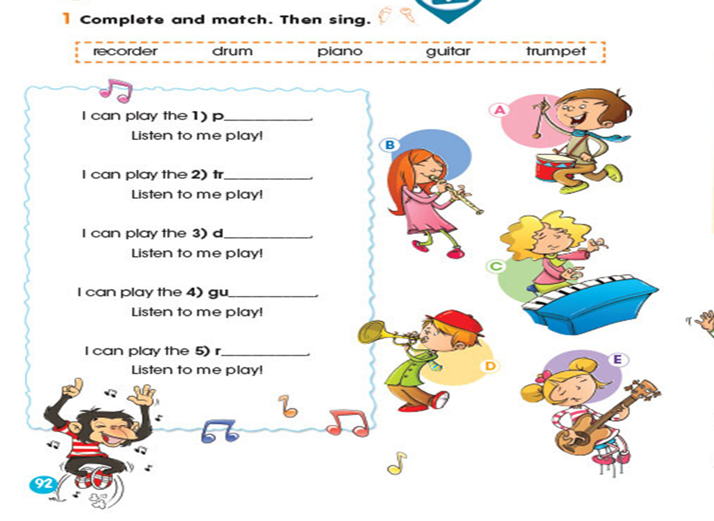
Sing the I can play …. song! complete and match .Then sing.

Slide 7
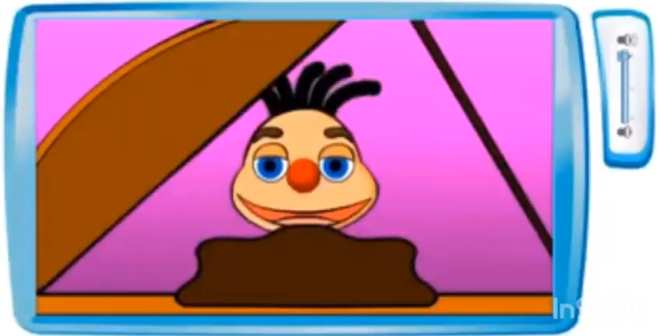

Slide 8
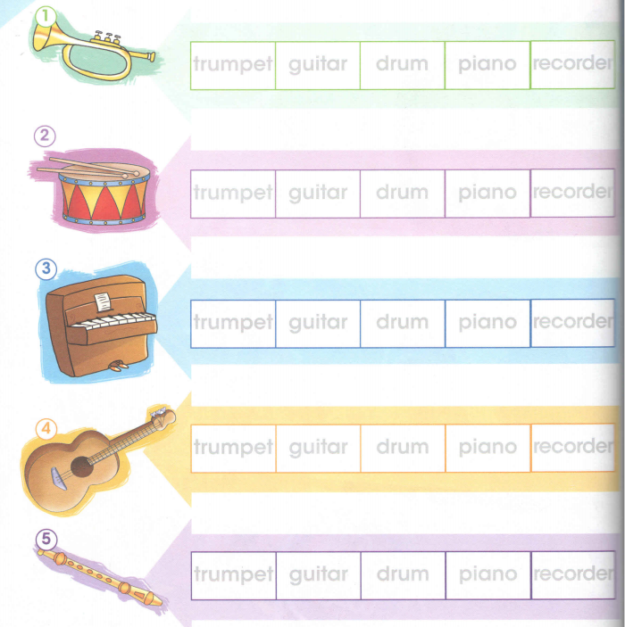
Look and choose the right word..

Slide 9

Now,let’s storytime!!
Watch the video…

Slide 10


Slide 11
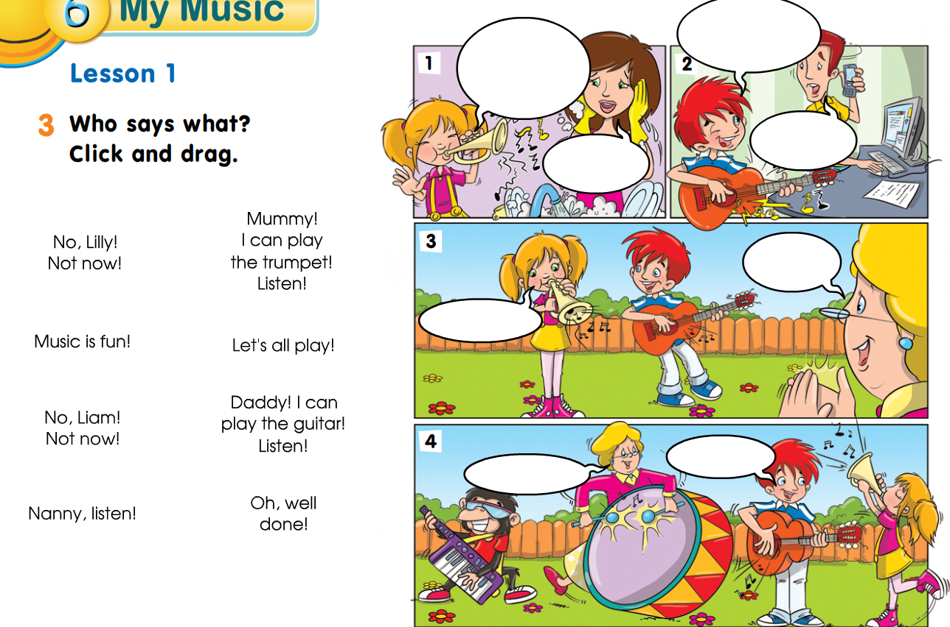

Slide 12

GOOD BYE STUDENTS!!!

