Slide 1

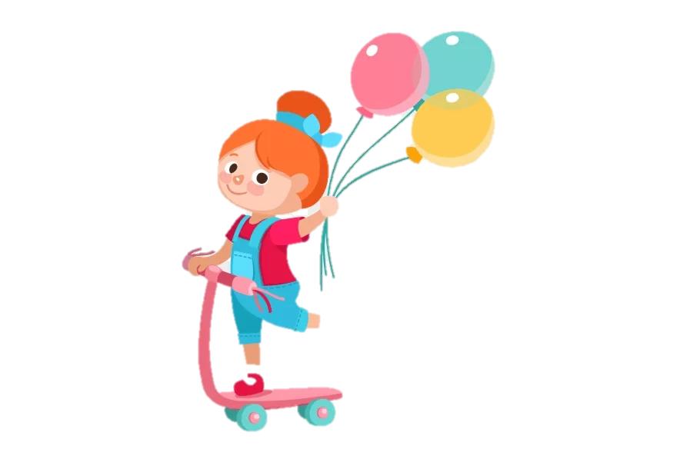
Hello, Children!

Slide 2

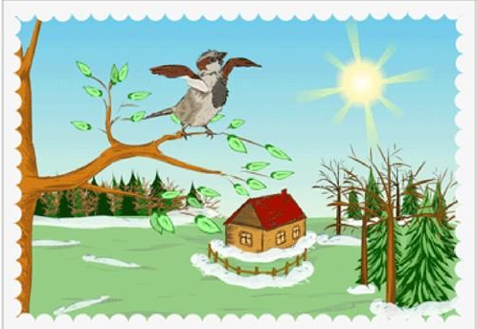
Theme:
Springtime in Kazakhstan

Slide 3

Lesson objectives:
To pronounce basic words and expressions intelligibly
To practice new words about Springtime

Slide 4


Let’s learn our new words

Slide 5
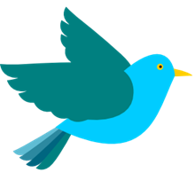





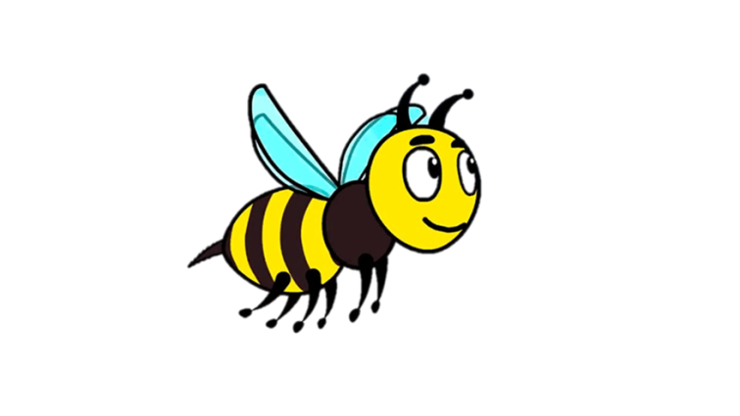


2
spring
bird
flower
grass
rainbow
leaf
bee
sun
tree

Slide 6






Let’s practice!
sun
bee
bird
grass
grass
spring
spring
leaf
rainbow
spring
leaf
rainbow

Slide 7





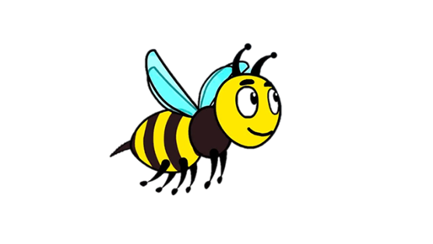

Let’s practice!
bee
sun
grass
bird
spring
spring
tree
sun
leaf
spring
leaf
grass

Slide 8










Put the correct letter for the beginning of each word
…lower
…rass
…ird
a
f
p
n
k
b
g
d
c
f
…pring
…un
…eaf
v
s
j
k
r
l
t
e
s
…ee
…ainbow
…ree
d
j
b
r
l
m
t
b
p

Slide 9





What is it?
It is green. -
It is yellow and black. -
It is singing a song. -
It smells good. –
It shines in the sky -

Slide 10
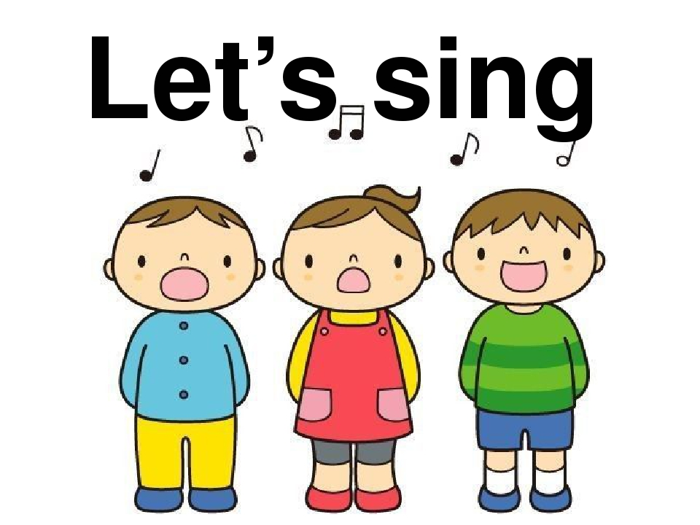

Slide 11



