Slide 1

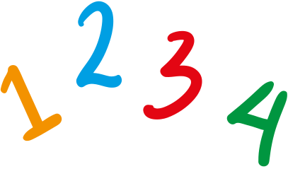
Name: ________________________________________
Class: ________________________________________
Көбейту
Қораптарды дұрыс өніммен толтырыңыз.
X | 1 | 2 | 3 | 4 | 5 | 6 | 7 | 8 | 9 | 10
2
X | 1 | 2 | 3 | 4 | 5 | 6 | 7 | 8 | 9 | 10
3
X | 1 | 2 | 3 | 4 | 5 | 6 | 7 | 8 | 9 | 10
4
X | 1 | 2 | 3 | 4 | 5 | 6 | 7 | 8 | 9 | 10
5

Slide 2
Name: ________________________________________
Class: ________________________________________
Multiplication
Fill in the boxes with the correct product.
X | 1 | 2 | 3 | 4 | 5 | 6 | 7 | 8 | 9 | 10
6
X | 1 | 2 | 3 | 4 | 5 | 6 | 7 | 8 | 9 | 10
7
X | 1 | 2 | 3 | 4 | 5 | 6 | 7 | 8 | 9 | 10
8
X | 1 | 2 | 3 | 4 | 5 | 6 | 7 | 8 | 9 | 10
9
X | 1 | 2 | 3 | 4 | 5 | 6 | 7 | 8 | 9 | 10
10

