Slide 1


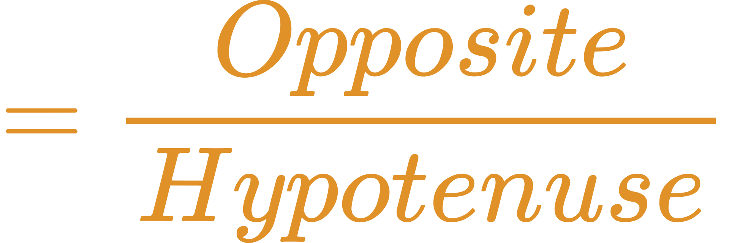
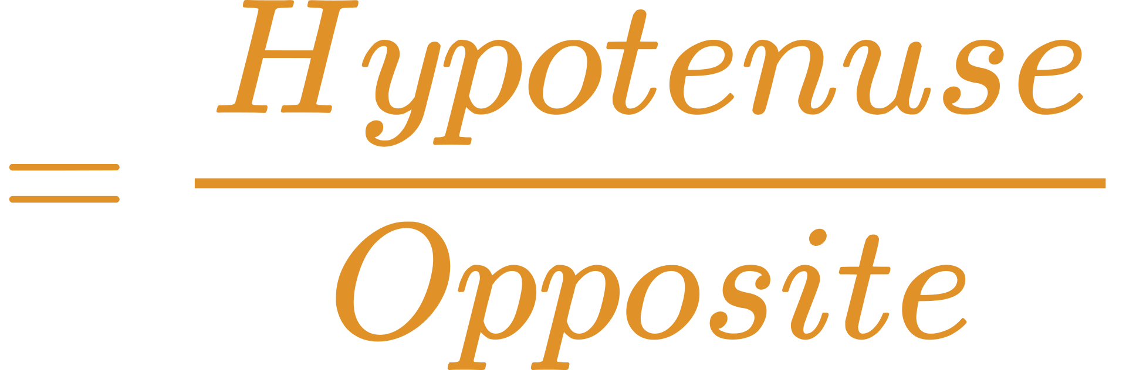

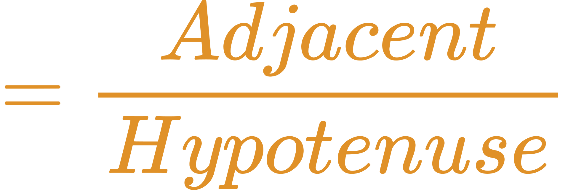
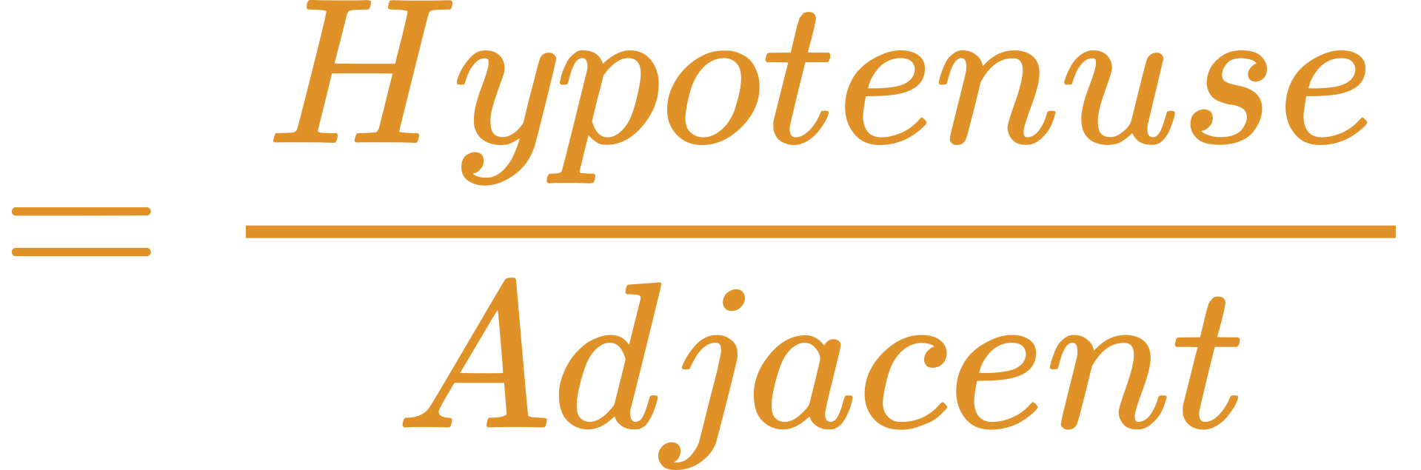
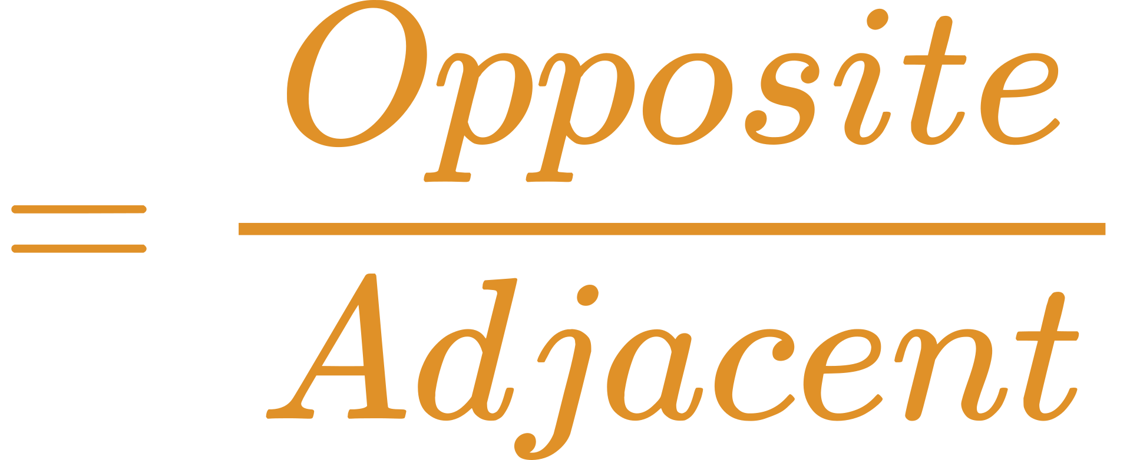
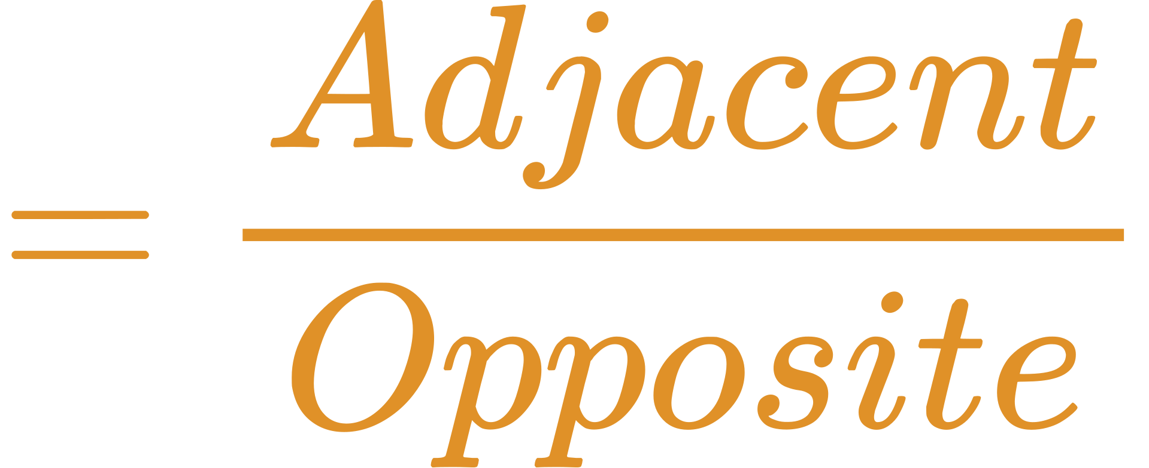

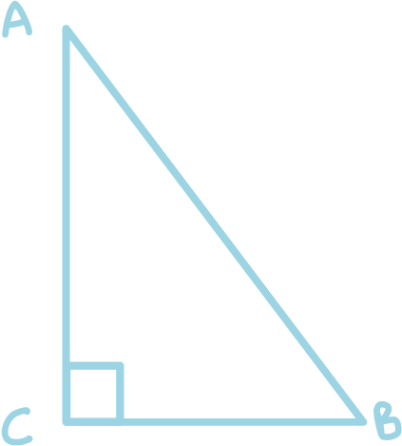
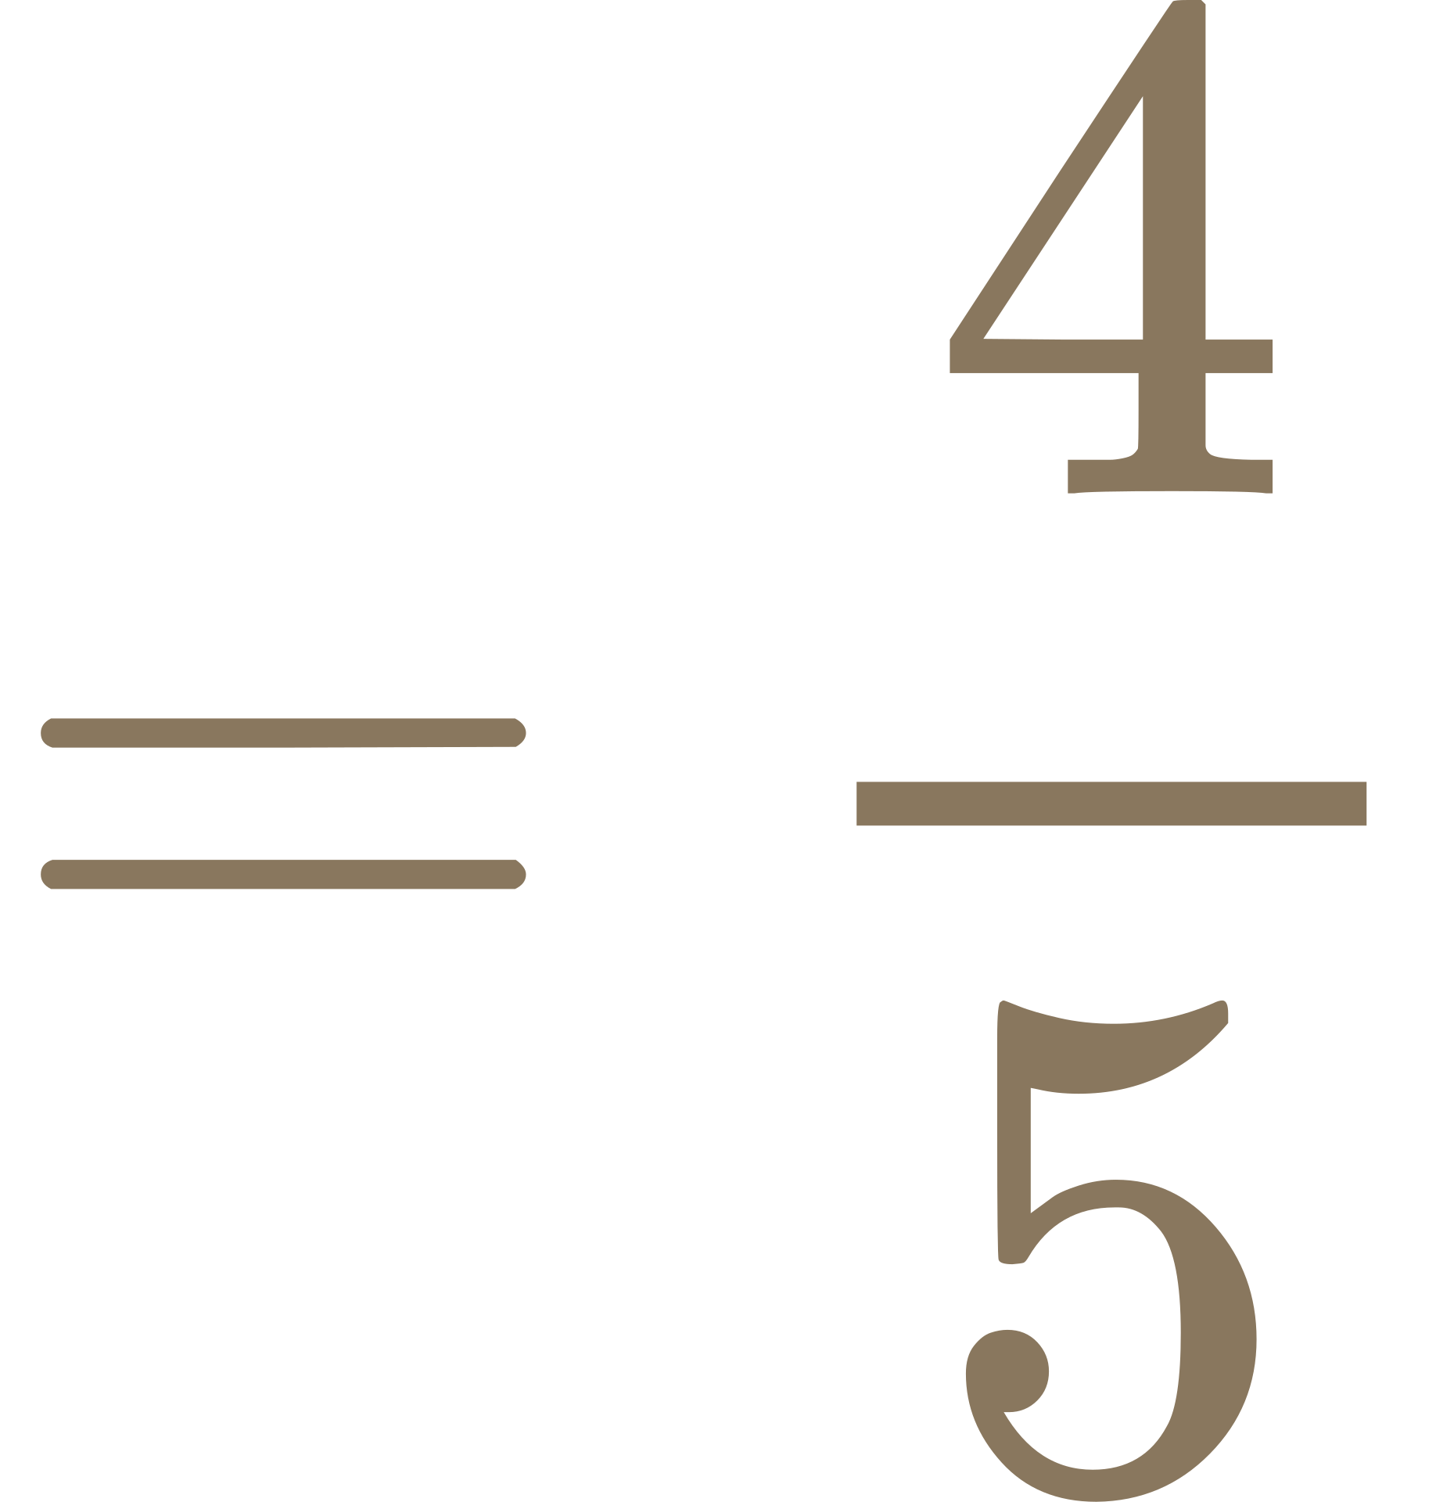
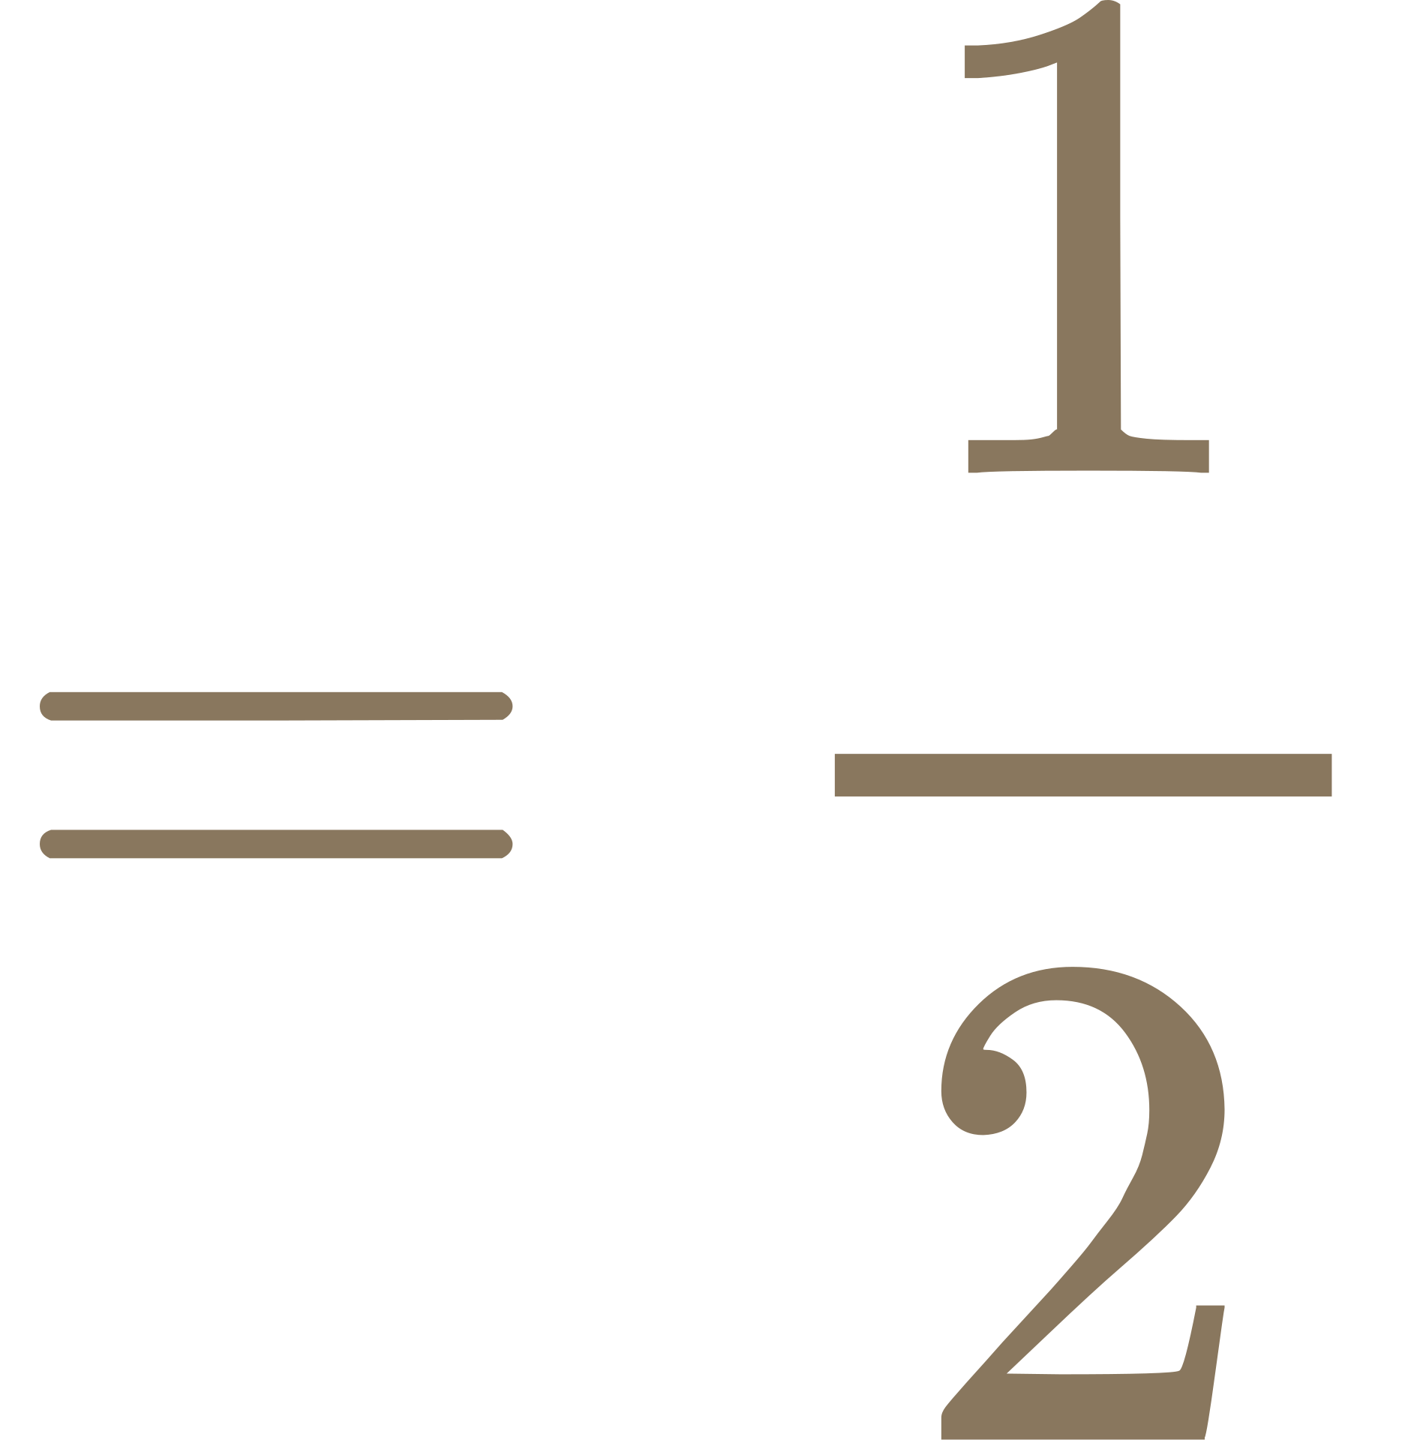

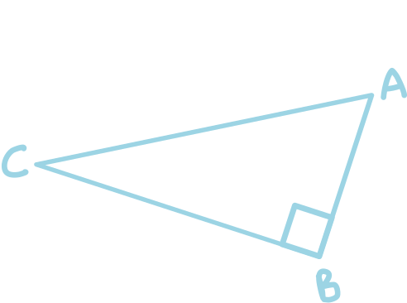
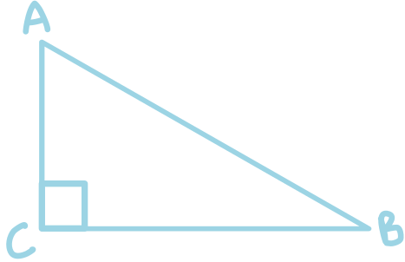
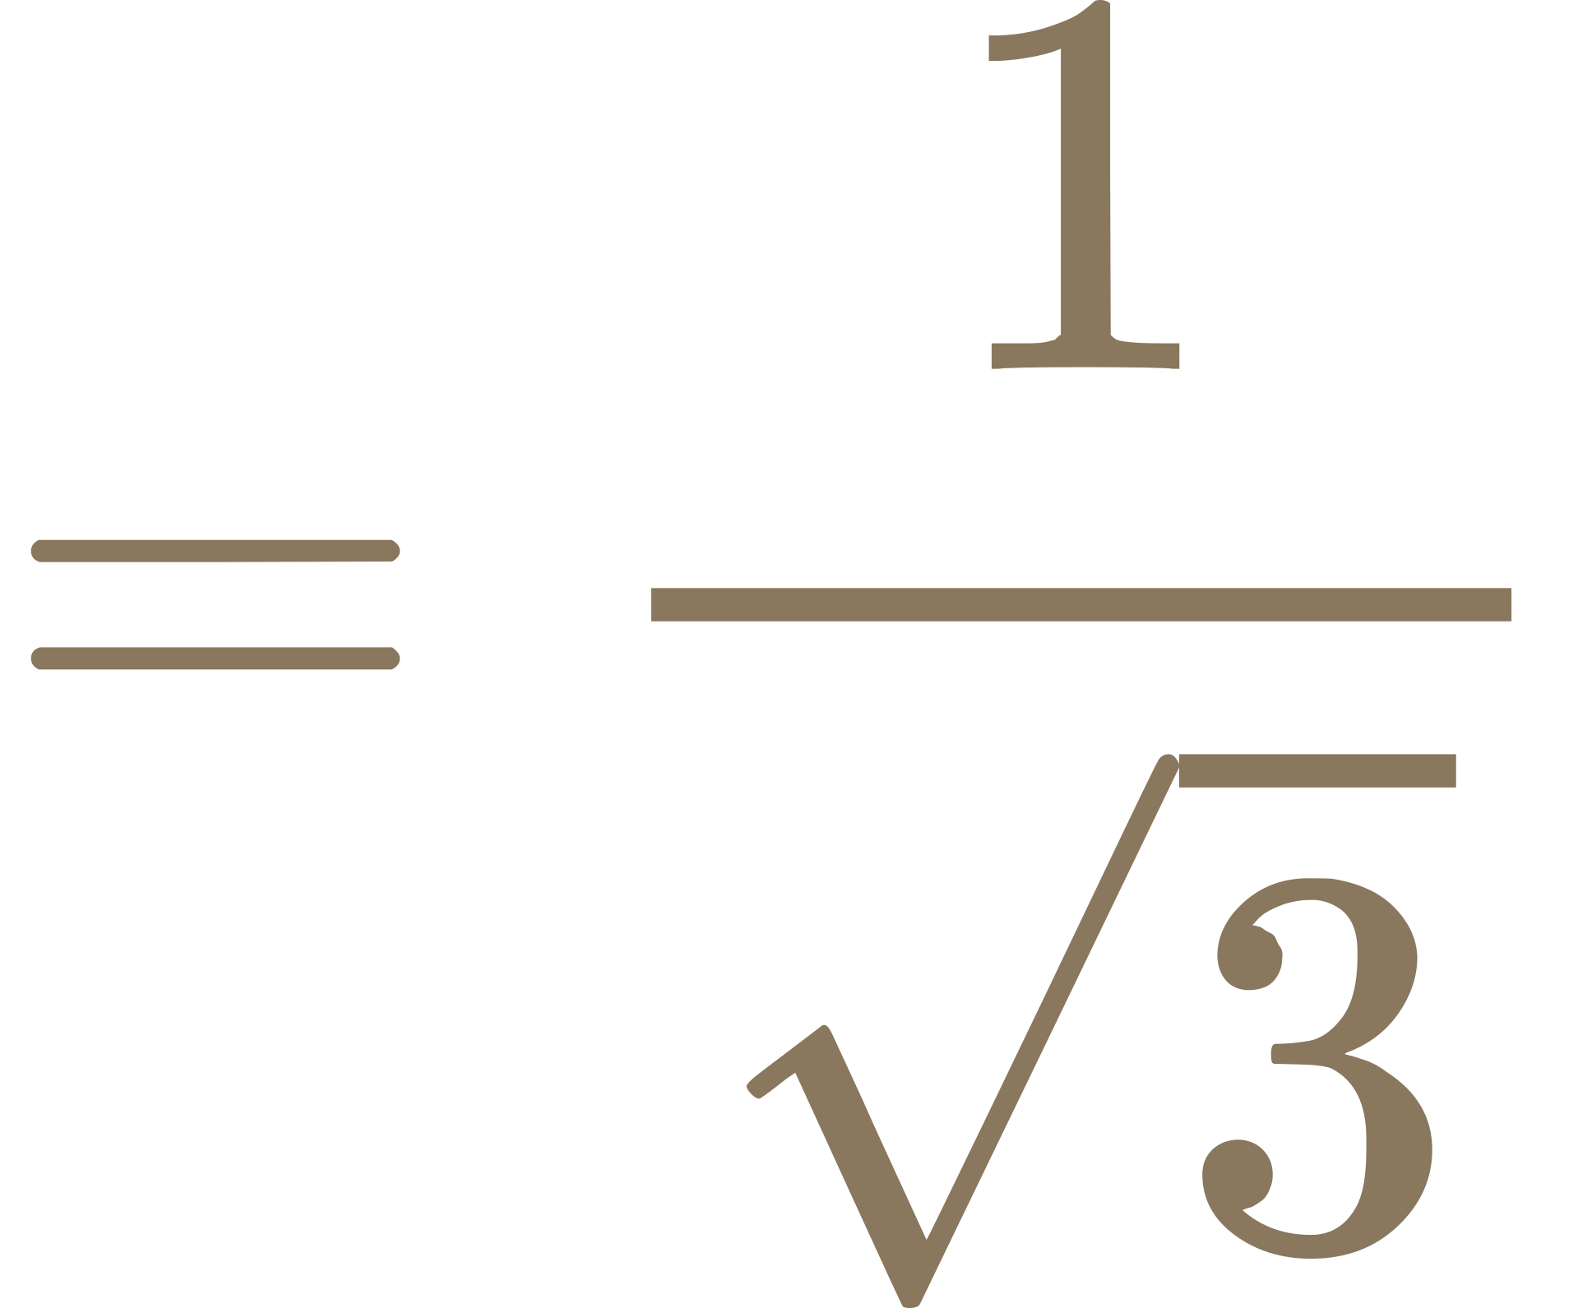
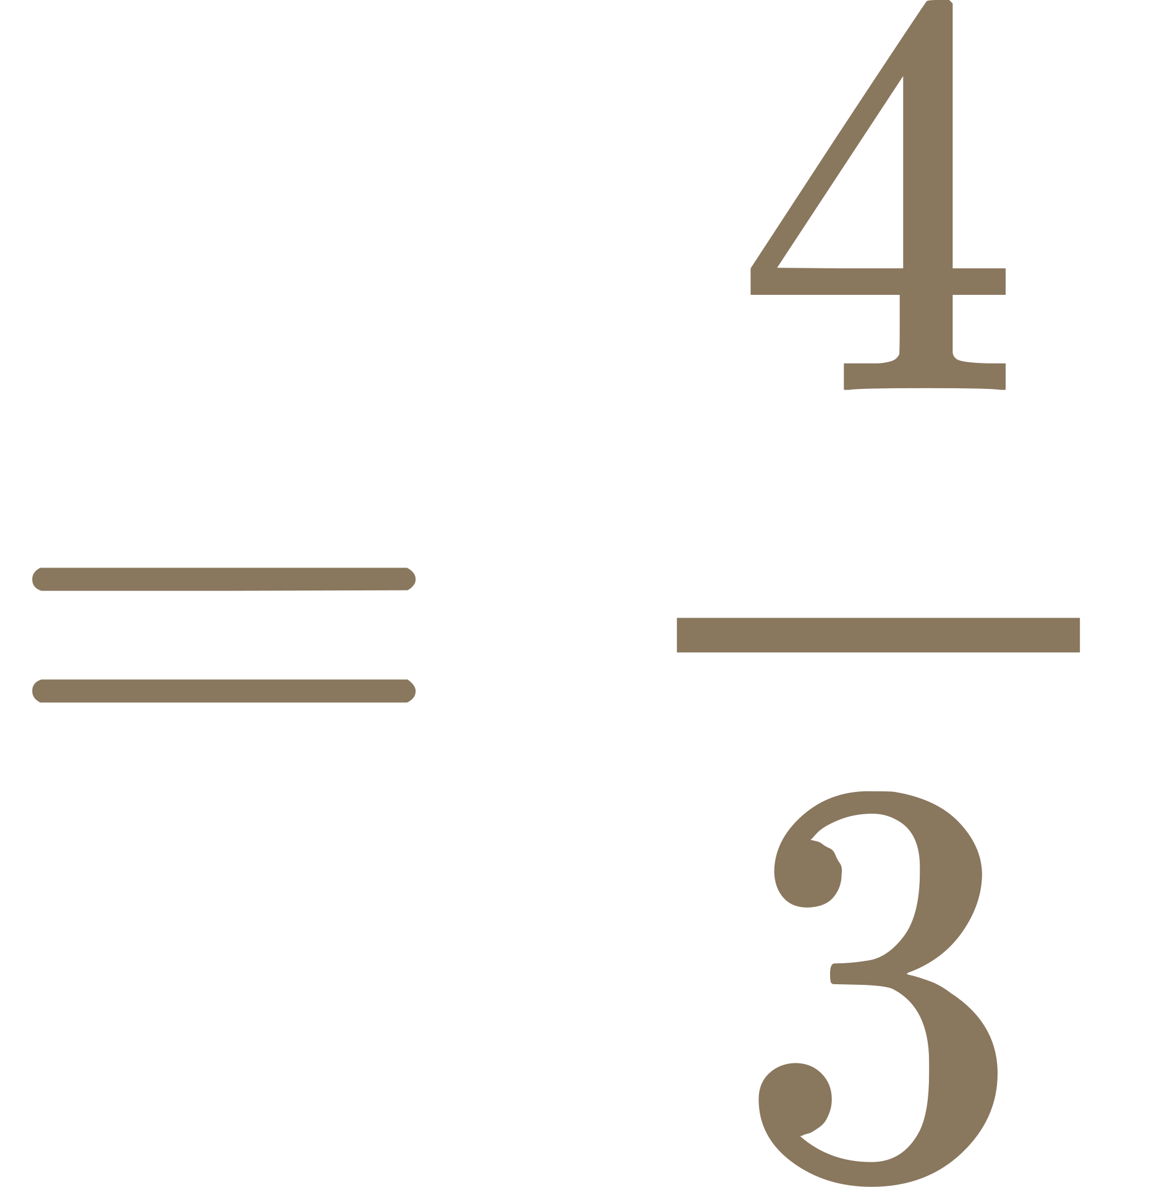
ТРИГОНОМЕТРИЯ ҚАТЫНАСЫ
Hint :
Sin
csc
With the given clue, place the correct label on each side. After that, find the unknown side of the triangle using the Pythagorean theorem,
Cos
Sec
Tan
Cot
1)
2)
Sin B
Cos A
4
5
?
1
2
5
?
3)
4)
Tan C
Csc A
1
V3
?
4
3
?

Slide 2
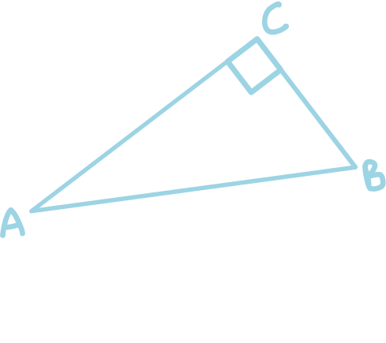
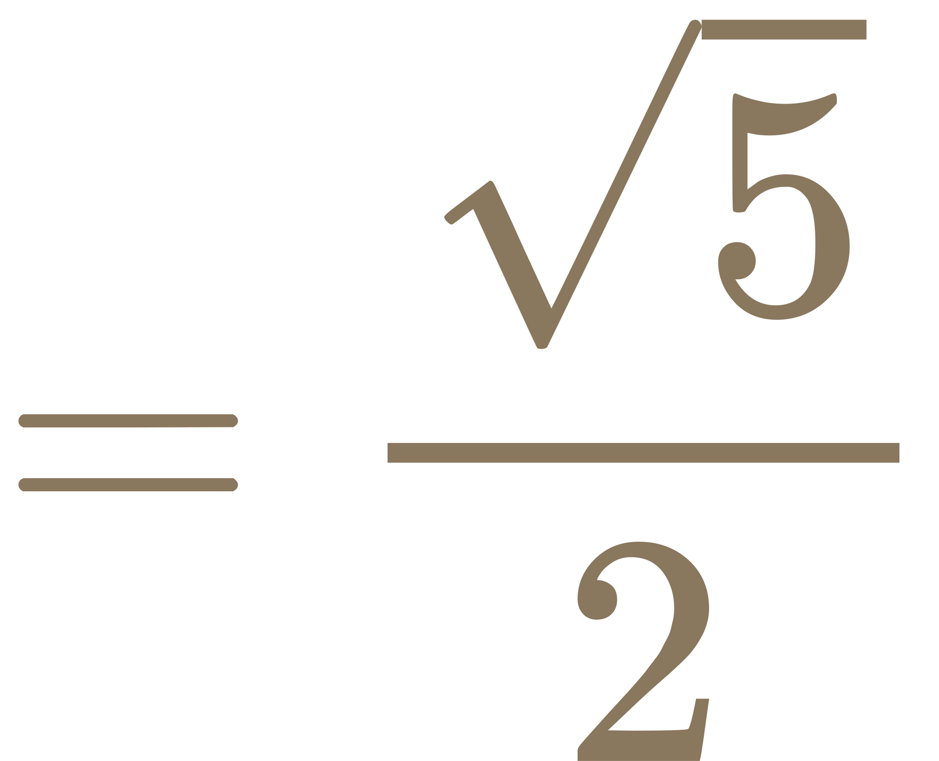
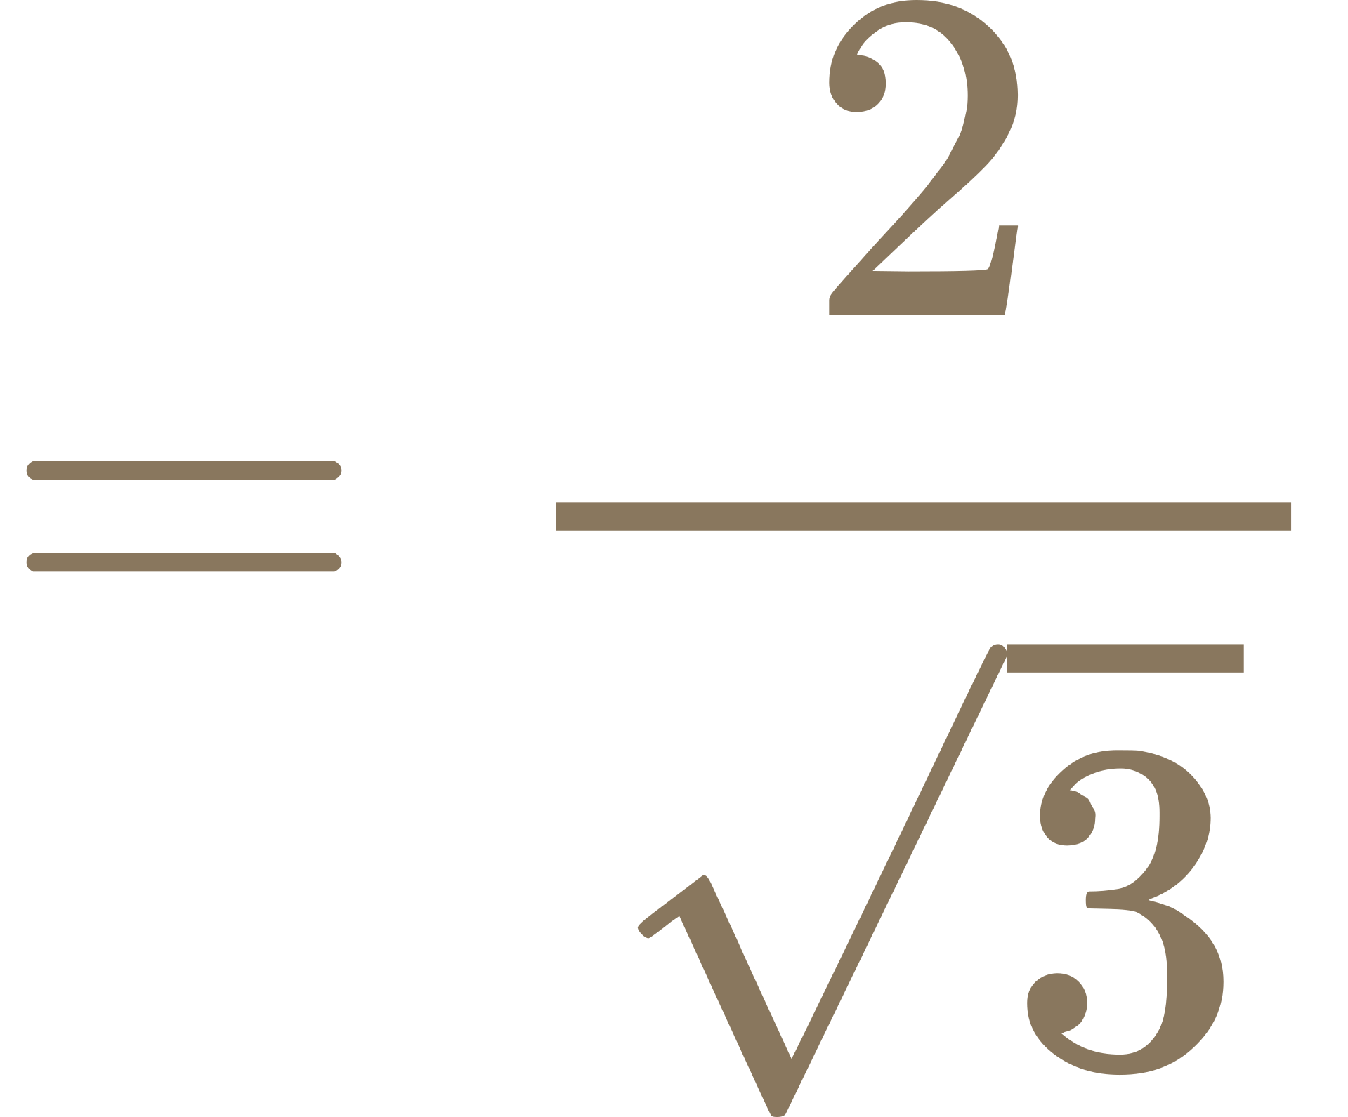
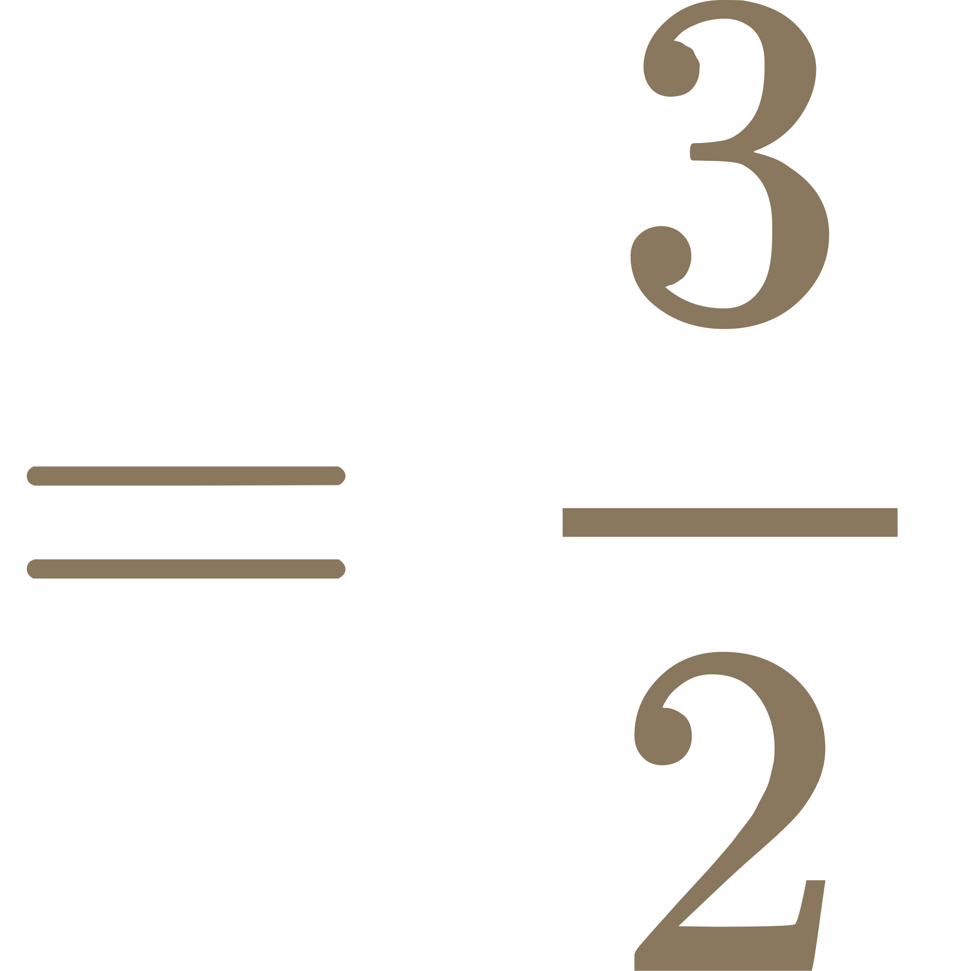
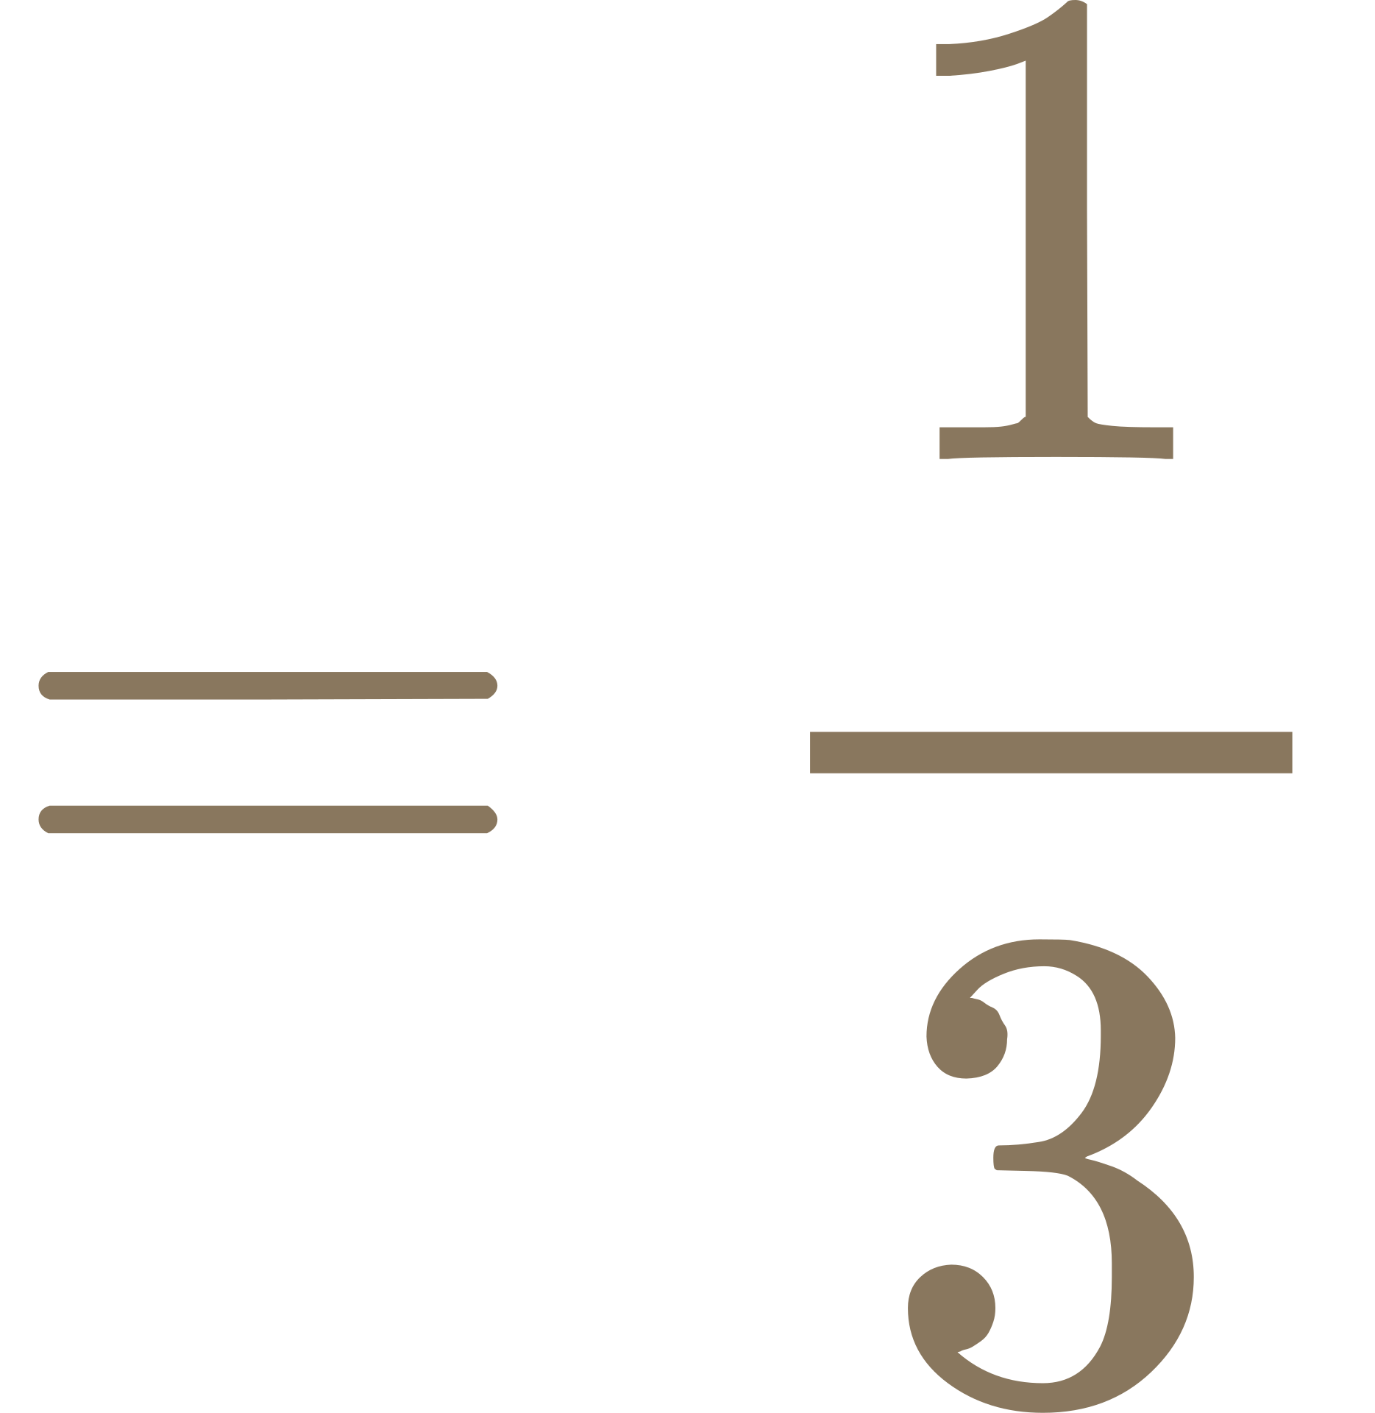
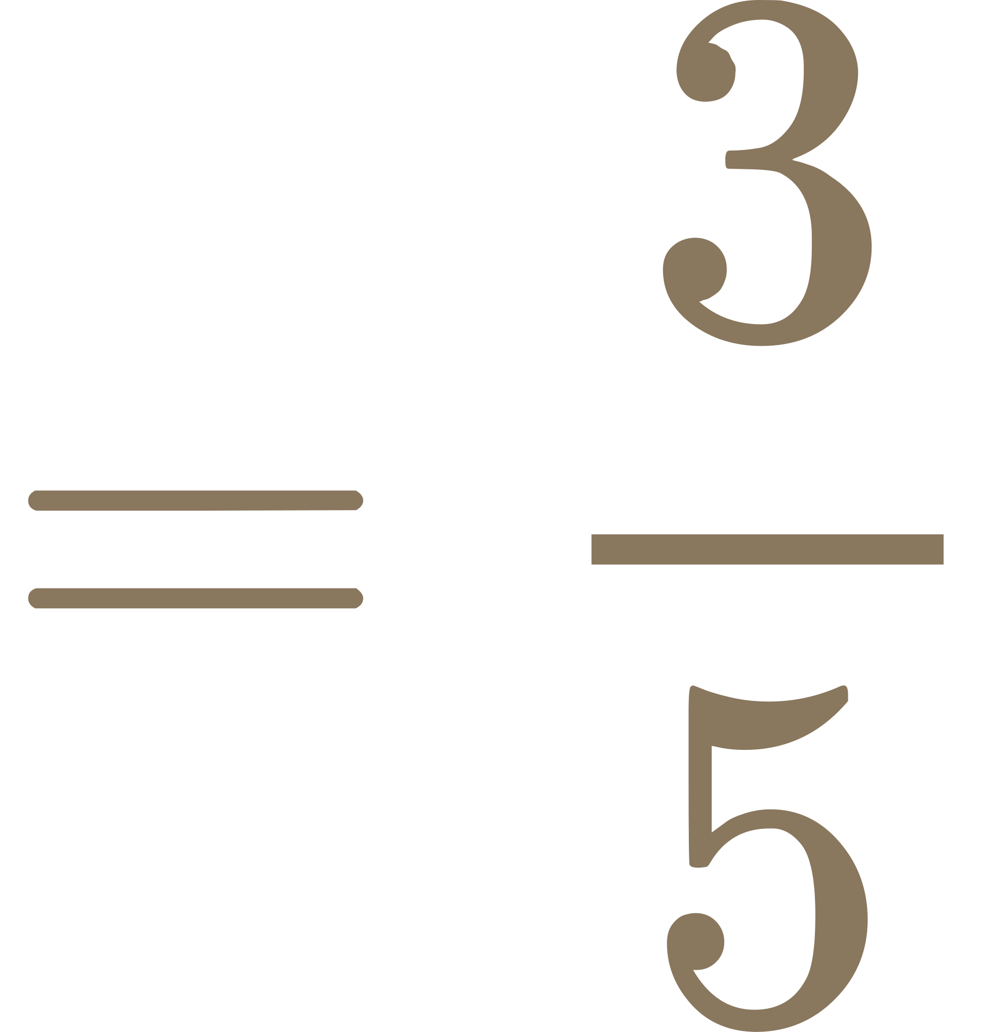
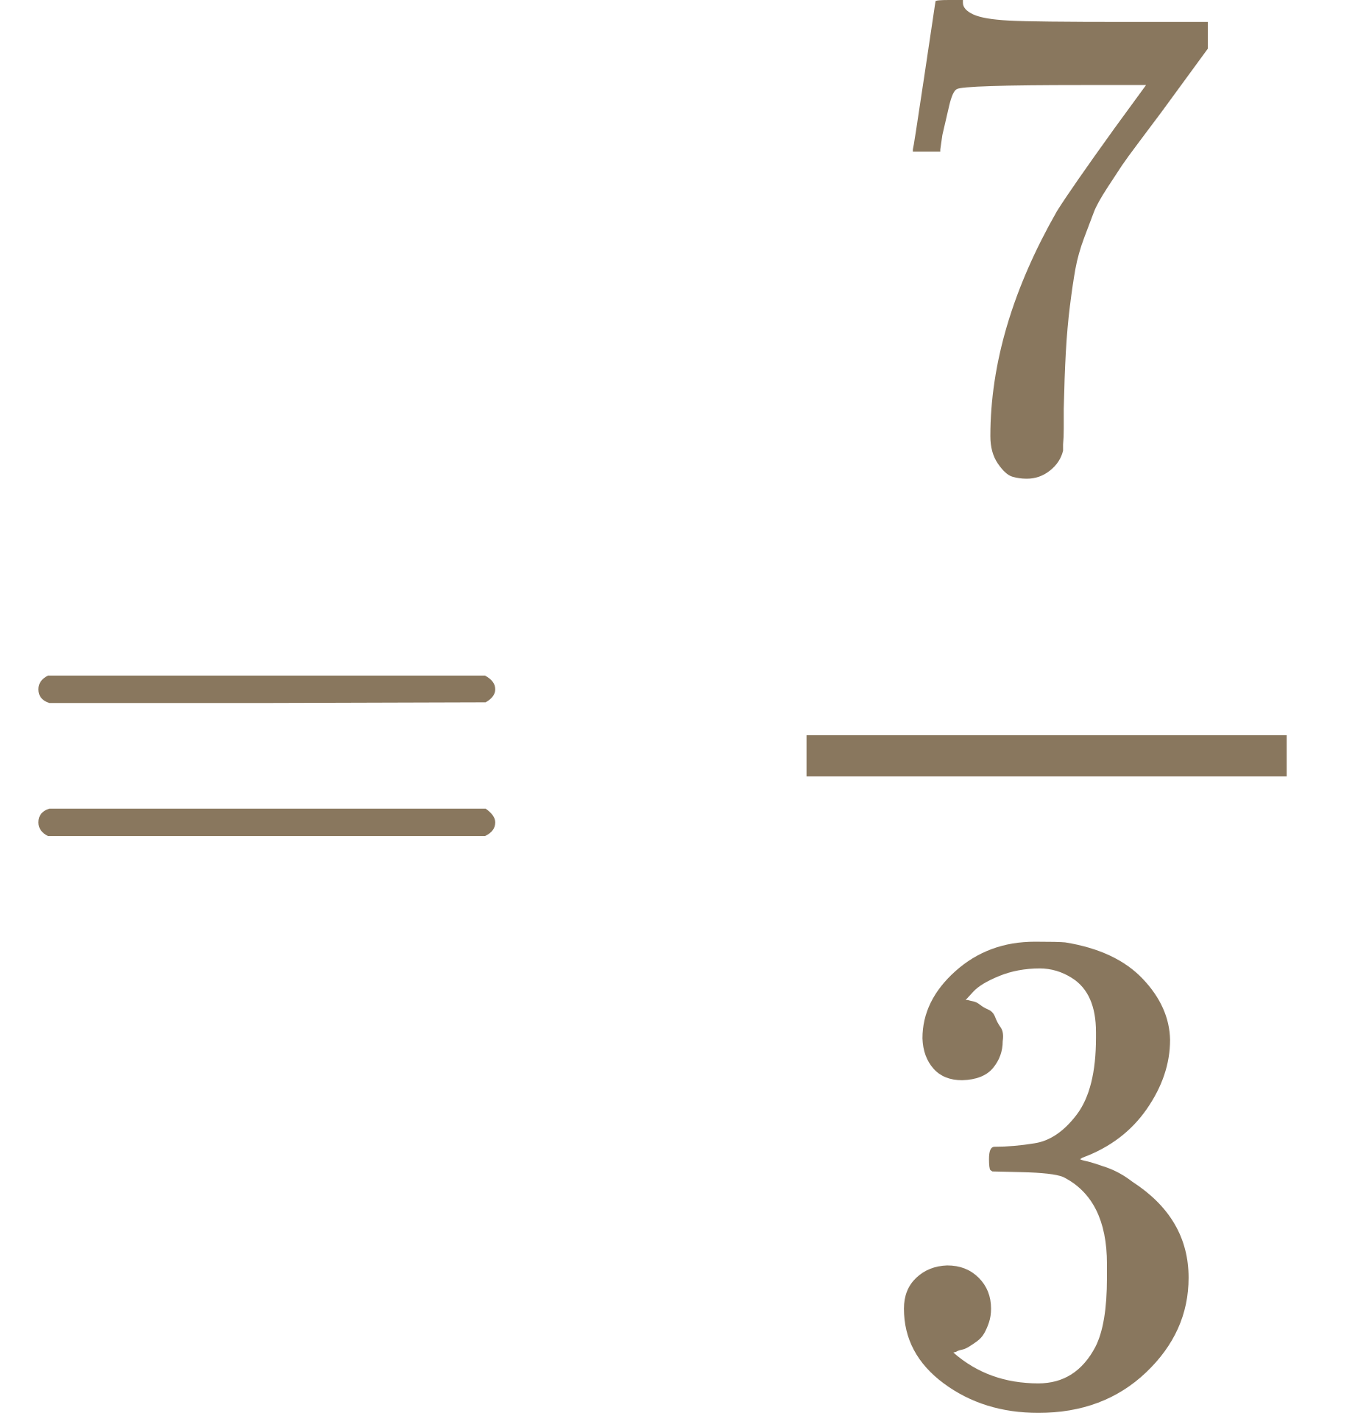
5)
6)
Sec B
Sec A
V5
2
?
2
V3
5
?
7)
8)
Cot B
Cos C
3
2
?
1
3
5
?
9)
10)
Sin B
Csc A
3
5
?
7
3
?

Slide 3

TRIGONOMETRY RATIO
Hint :
Sin
csc
With the given clue, place the correct label on each side. After that, find the unknown side of the triangle using the Pythagorean theorem,
Cos
Sec
Tan
Cot
ANSWER KEY
1)
2)
Sin B
5
Cos A
2
4
1
5
3
V3
3)
4)
2
4
Tan C
Csc A
V7
1
V3
3

Slide 4
5)
6)
2
1
2
Sec B
Sec A
V3
V5
5
1
7)
8)
3
Cot B
V13
Cos C
2
V8
5
1
3
9)
10)
3
4
7
Sin B
Csc A
V40
5
3

Slide 5


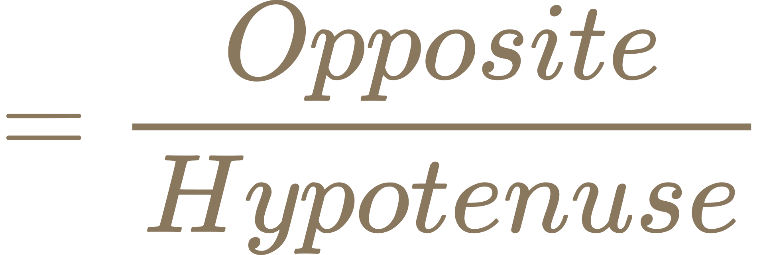


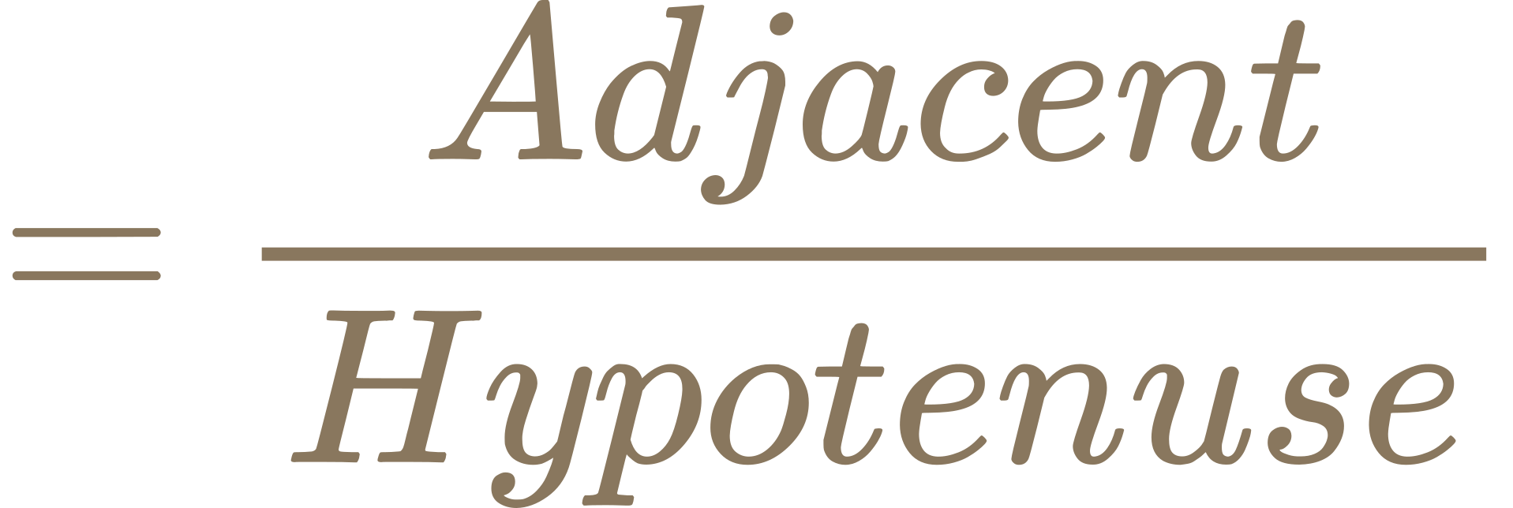


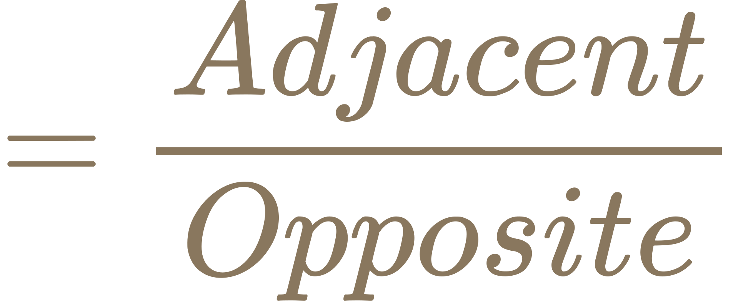


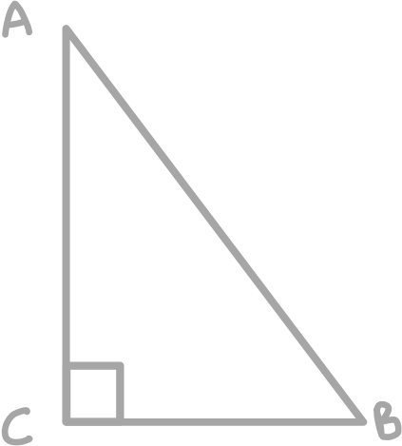
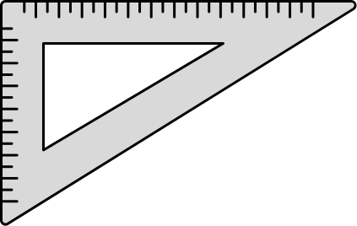
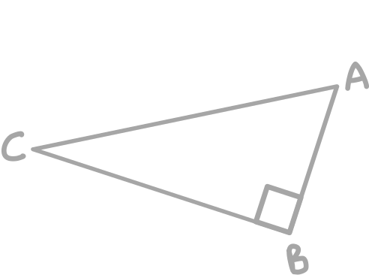
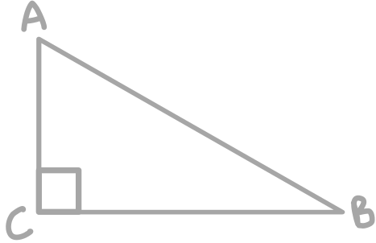
TRIGONOMETRY RATIO
Hint :
Sin
csc
With the given clue, write the correct number on each side. After that, find the unknown side of the triangle using the Pythagorean theorem.
Cos
Sec
Tan
Cot
PRINT VERSION
1)
2)
Sin B
Cos A
5
3)
4)
Tan C
Csc A

Slide 6
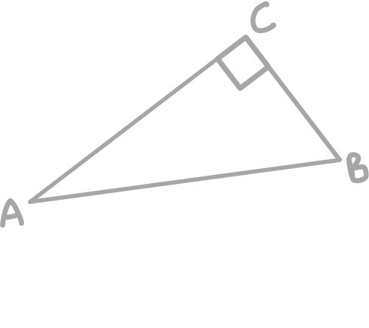
5)
6)
Sec B
Sec A
5
7)
8)
Cot B
Cos C
5
9)
10)
Sin B
Csc A

